Slide 1
Introduction to R
Thanos Mourikis
thanos.mourikis@novartis.com
Oncology Data Science,
Novartis Institutes for BioMedical Research

Slide 2


Slide 3
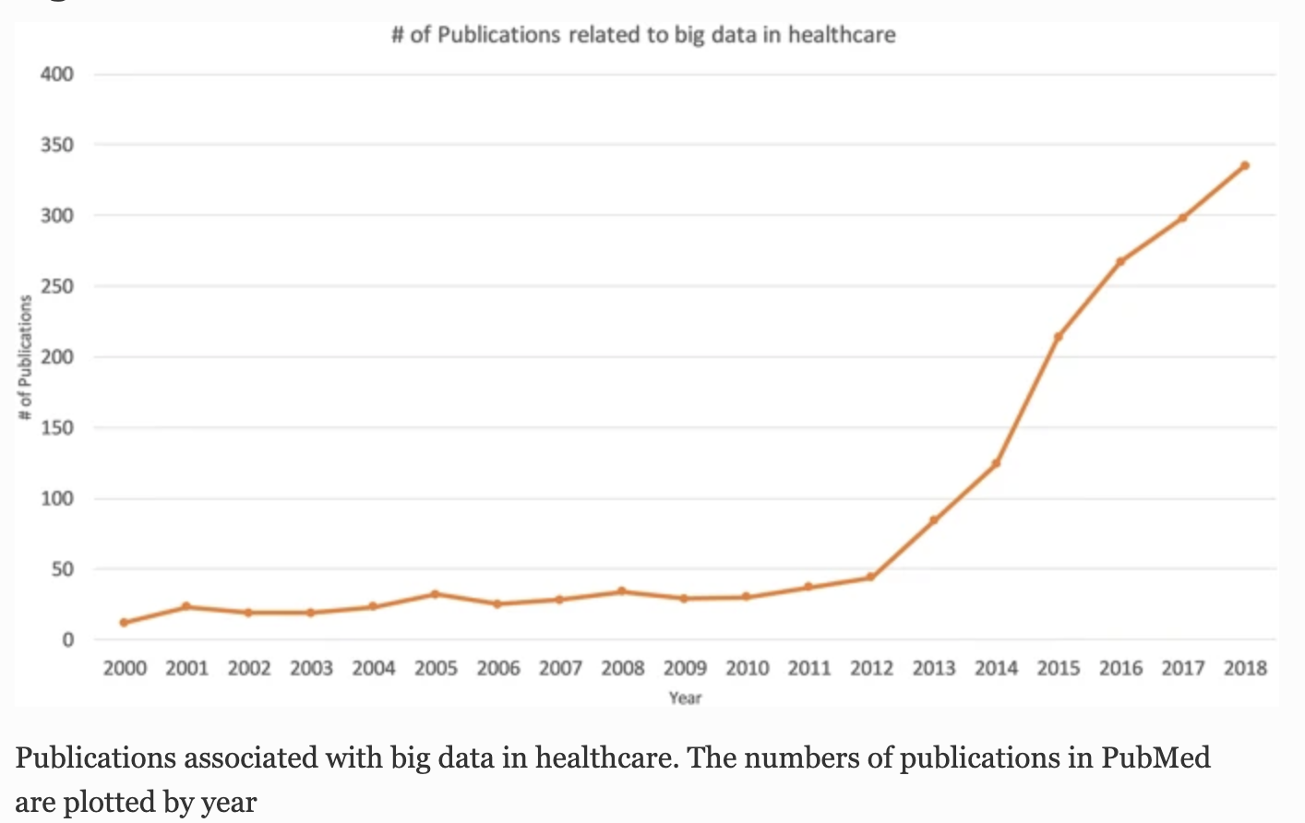
Big Data in Biomedical Research
Dash et al., Journal of Big Data, 2019

Slide 4
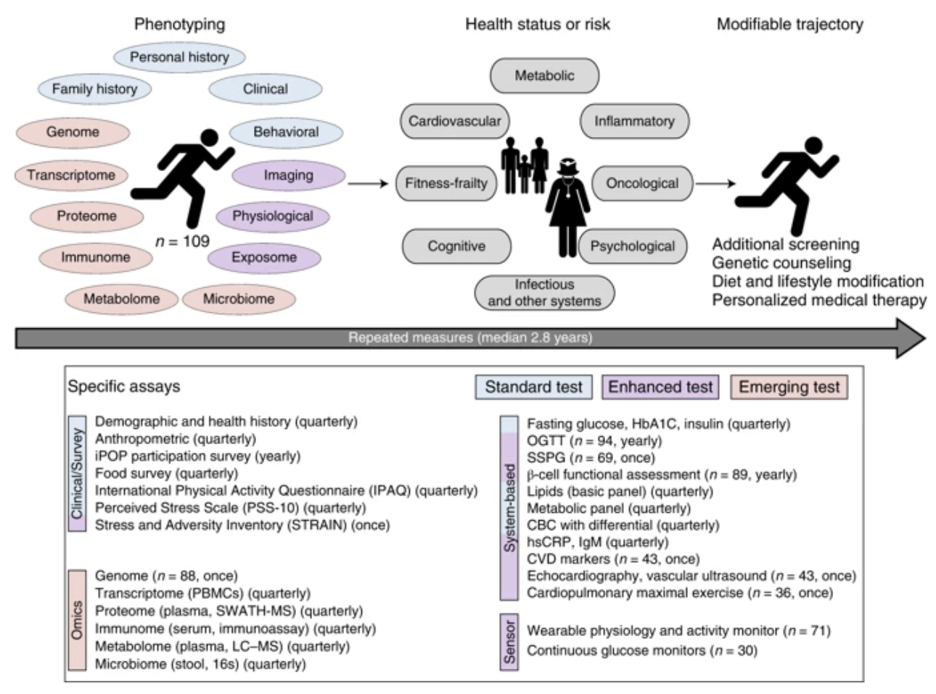
Big data approach in precision medicine
Schüssler-Fiorenza Rose et al., Nature Medicine, 2019

Slide 5
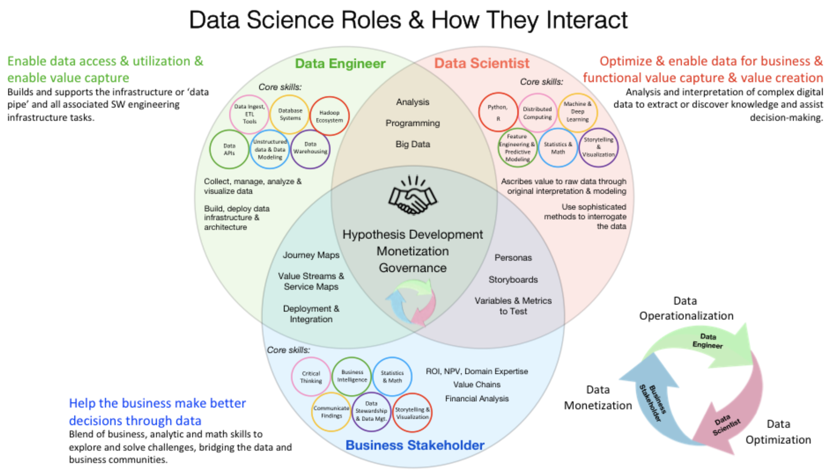

Slide 6
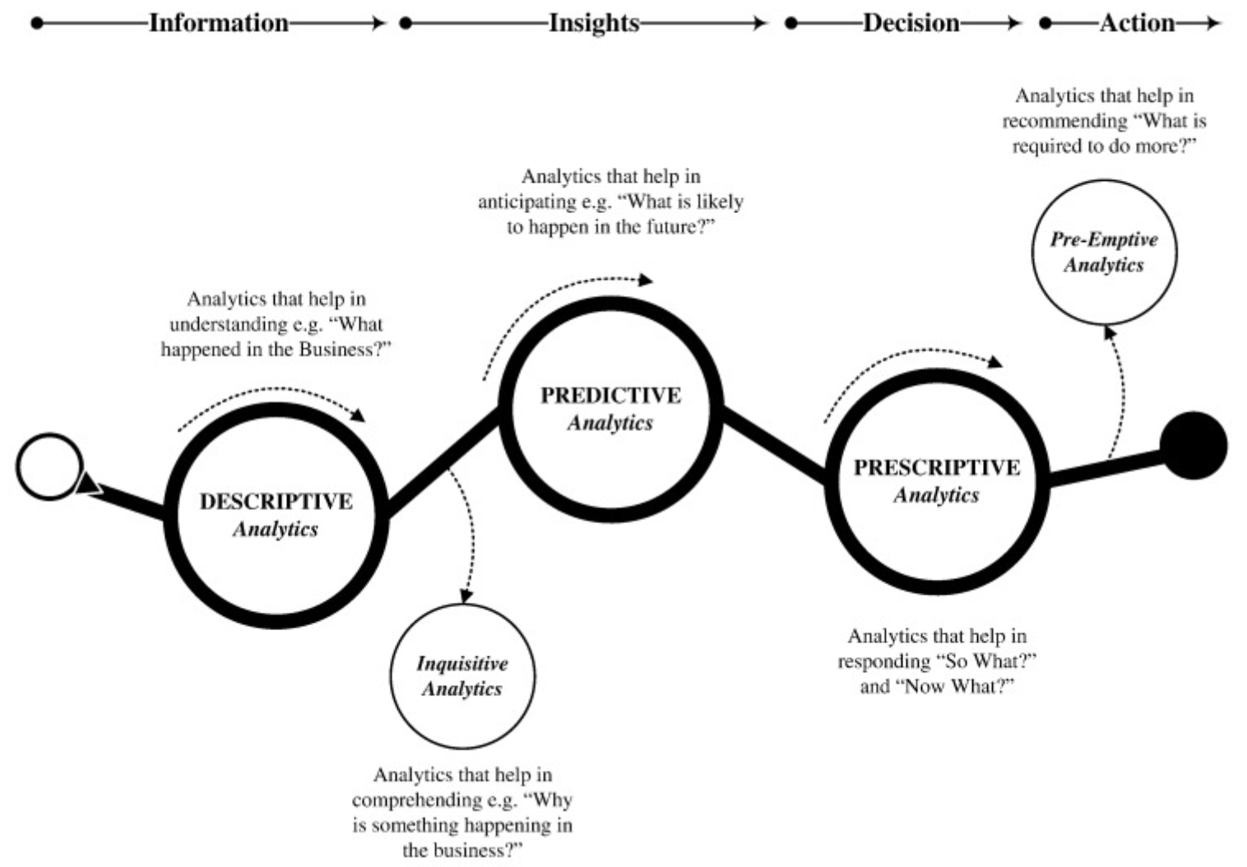
Types of Big Data analytical methods
Sivarajah et al., Journal of Business Research, 2017

Slide 7
Quiz
What is R?
Can you write and explain some of the most common syntax in R?
How do you list the preloaded datasets in R?
How do you assign a variable in R?
What are the different data types/objects in R?
How do you import data in R?
How do you install a package in R?
How do you concatenate strings in R?

Slide 8
Overview
Set up your environment
Libraries
Variables, assignment and logical operators
Vectors, Matrices, Lists, Data frames
Missing data (NA, NaN)
Reading and writing data frames
Factors
Conditional statements and loops
Functions
Generating and manipulating strings
Regular expressions
Advanced packages for data wrangling
Plotting
Bioconductor – write your own script to analyze a DNA/RNA sequence

Slide 9
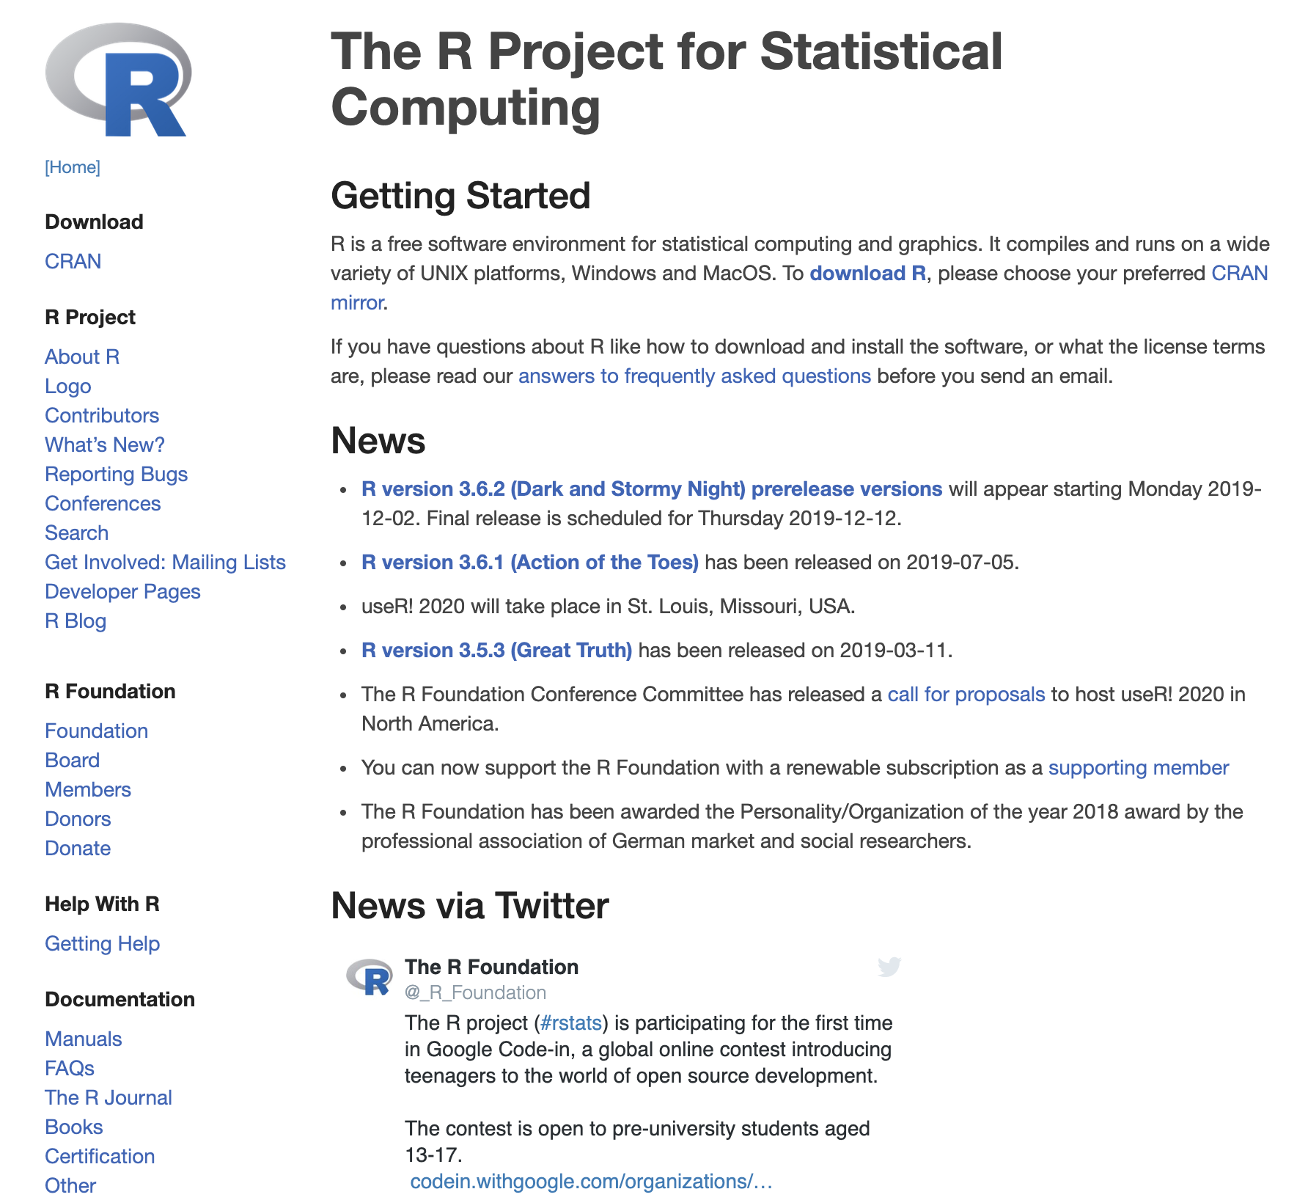
R installation
(https://cran.r-project.org/)

Slide 10
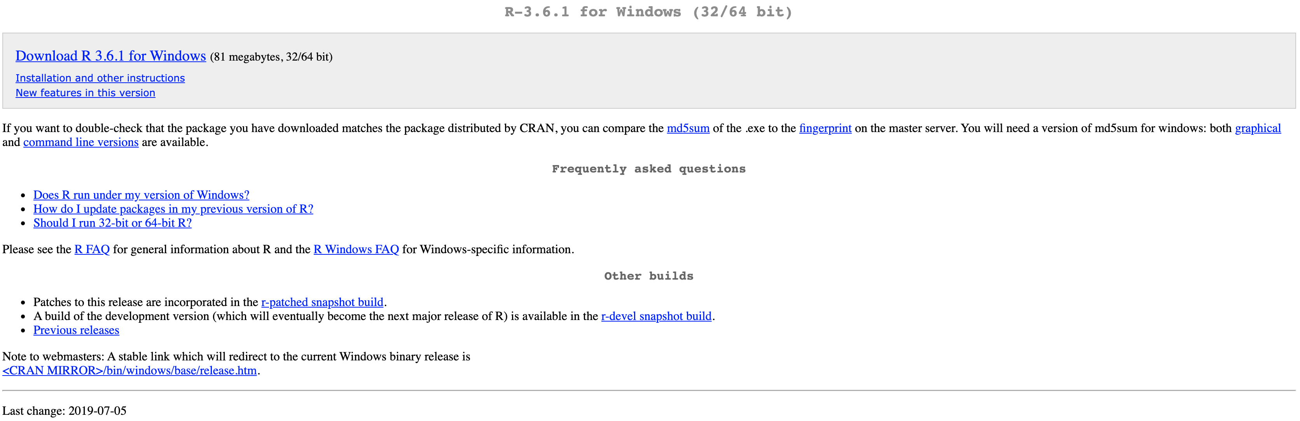
R installation
https://cran.r-project.org/bin/windows/base/

Slide 11
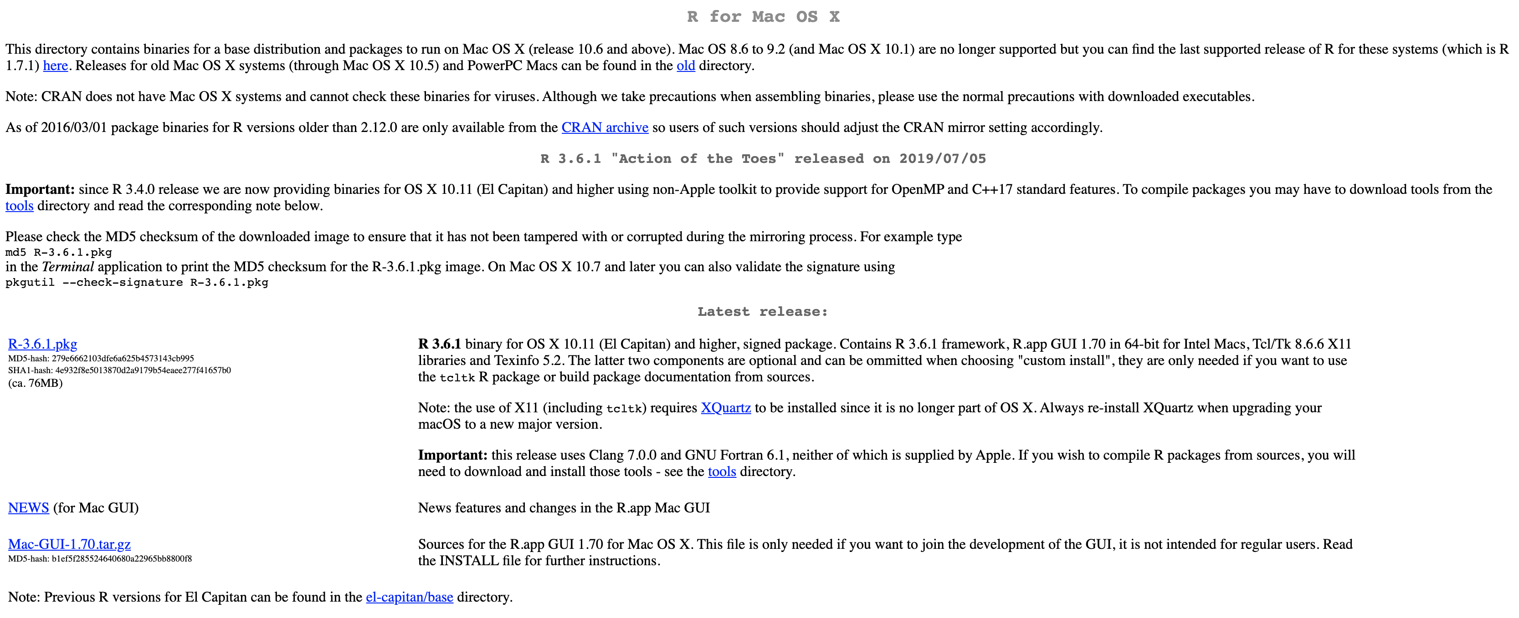
R installation
https://cran.r-project.org/bin/macosx/

Slide 12
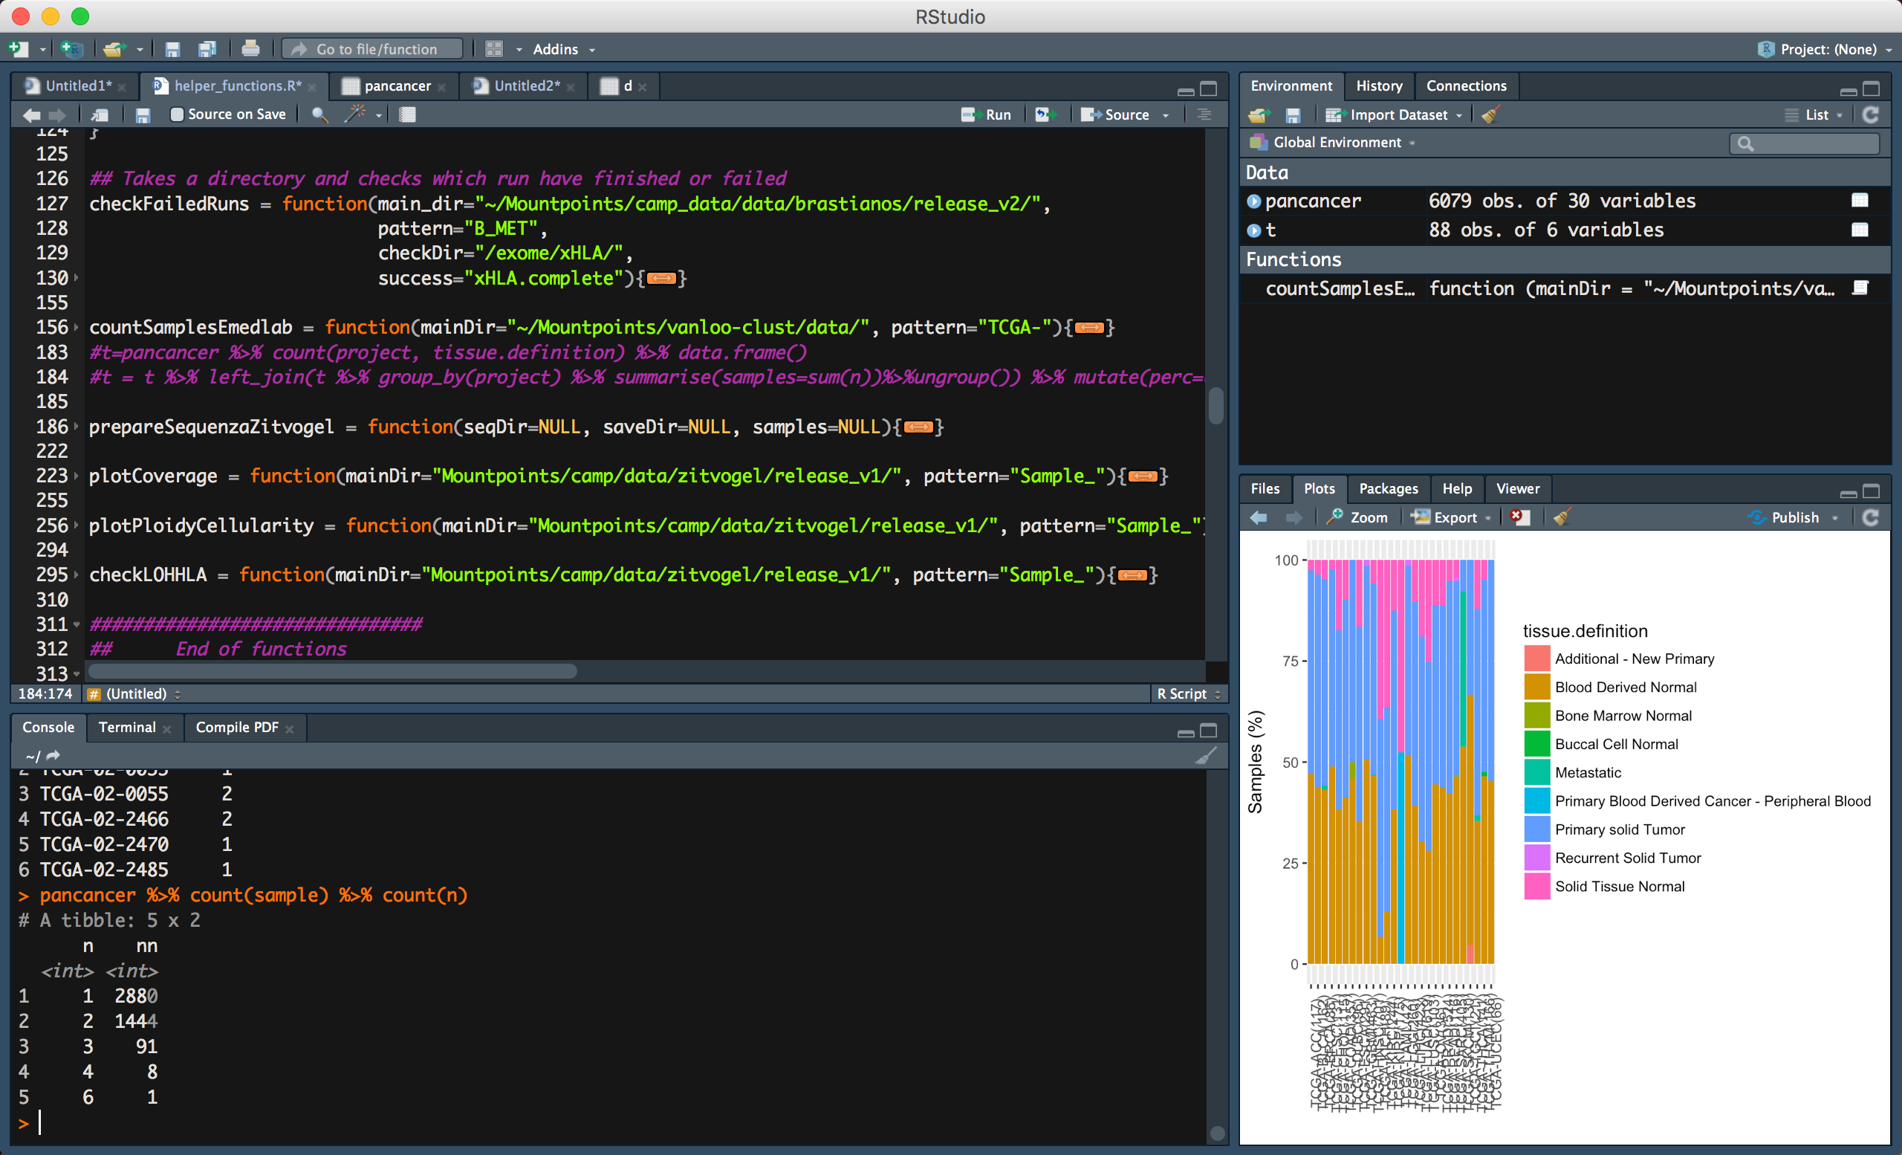
Rstudio (IDE)
Editor
Environment
Console
Additional windows

Slide 13

Rstudio installation
https://www.rstudio.com/products/rstudio/download/

Slide 14
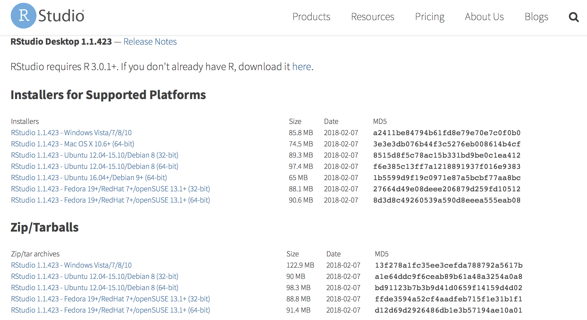
Rstudio installation

Slide 15
Open Rstudio
Create your first script
Write on top
# Introduction to R
4. Save it as intro.R

Slide 16
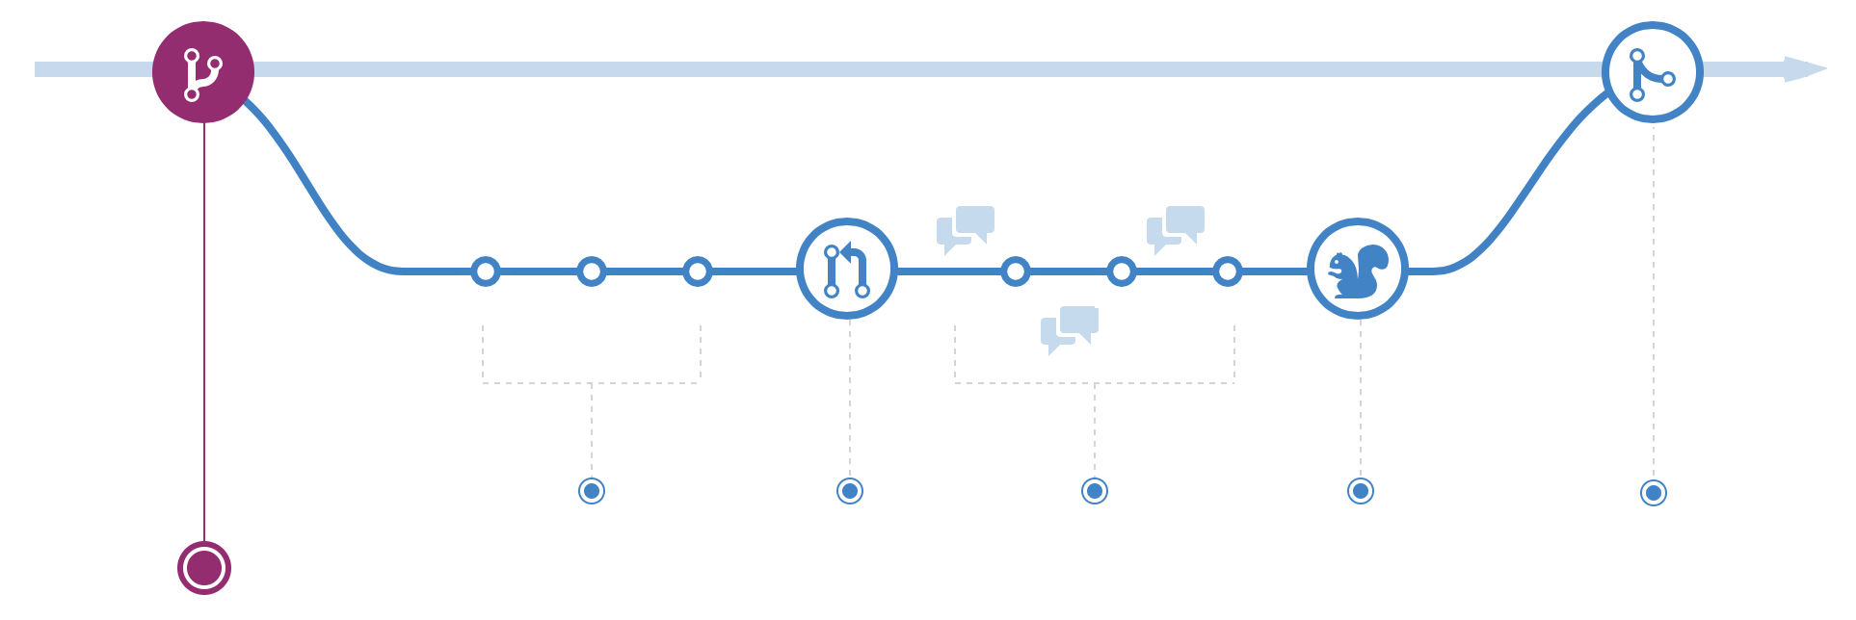
Git - version control system for tracking changes
Scripts are not static and you are not the only one working on them!
https://github.com/thmourikis/Introduction2R

Slide 17

Collaborating on shared repositories

Slide 18
Why R?
Open source and free
Statistical packages are usually implemented initially in R
Biological packages are usually implemented initially in R
Phenomenal diversity in graphics and illustrations
Excellent combination with markdown, shiny, for reproducible and sharable research
Easy experimentation via the interactive mode and integrated datasets

Slide 19
Libraries
There are too many R commands to load into memory when R session starts
Therefore, R commands are organized as packages
For example, ‘base’ contains basic commands, the package ‘stats’ contains statistic commands such as distributions, statistical tests etc
A selection of important packages (see library(lib.loc=.Library)) is loaded at startup.
There is a special command to load libraries manually:
> install.packages(“dplyr”) # install the package
> library(dplyr) # load the package
> installed.packages() # See installed packages, use View()
> help(package="dplyr") ## See help

Slide 20
R as a calculator
> 5+5 # Addition
[1] 10
> # This is a comment
> 2^2; 7/3 # Multiple commands can be separated with ‘;’
[1] 4
[1] 2.33333
> 2+2*3^2 # Precedence rules – use parenthesis otherwise
[1] 20
> 3,2
[1] Error: unexpected ',' in "3,”
> 5/3 # division
[1] 1.666667

Slide 21
R as a calculator
> 5%/%3 # Integer division
[1] 1
> 5%%3 # Modulo division
2
> max(c(1,2,3,4) ) # Finding maximum/minimum
[1] 4
What about the minimum of a series of numbers?

Slide 22
Getting help
> help(read.table)
> help(“read.table”)
> help.start() # displays several useful links
> ?read.table
> ??read.table # same as help.search
> example(read.table)

Slide 23
Variable
Reserved memory locations in which we store values.
x <- 5
y <- “Hello”
z <- TRUE
x = 5
y = “Hello”
z = TRUE
Memory

Slide 24
Assignments, comparisons, and logical expressions
> x <- 5 # The variable x is assigned the value 5
> x
[1] 5
> x <- 5
> x <- 3
> x # What’s the value of x?
> 6 -> x # equivalent to x <- 6 but unusual
> x
[1] 6
> x = 7 # equivalent to x <- 7
> x
[1] 7
> y <- x^2 + 3 # assign 7^2 + 3 to the variable y
> y
[1] 52

Slide 25
Assignments, comparisons, and logical expressions
The reserved location in memory can also store the definitions of functions
> myfunction <- max # assignment of a function
> myfunction(1, 2, 3, 4)
[1] 4
> myfunction <- min
> myfunction(1, 2, 3, 4)
[1] 1
> myfunction <- sqrt
> myfunction(81)
[1] 9
myfunction <- max()
max()
memory
memory
=

Slide 26
Assignments, comparisons, and logical expressions
Subsets of large data sets (e.g data frames) are accessed by selecting all elements which have certain 'properties’.
'Properties' are formulated with logical expressions which we now introduce.
> 4 == 4 # Are both sides equal?
[1] TRUE # TRUE is an R constant
> 4 == 5
[1] FALSE # FALSE is an R constant
> 4 == 3 + 1
[1] TRUE
> 3 <= 4
[1] TRUE
> 5 > 2*2
[1] TRUE

Slide 27
Assignments, comparisons, and logical expressions
> 5 > 2+3
[1] FALSE
> 4 != 3 # ! is negation, != is 'not equal'
[1] TRUE
> 3 != 3
[1] FALSE
> 2 != 3
[1] TRUE
> TRUE & TRUE # & is the logical AND. Result is TRUE if
[1] TRUE # both expressions are TRUE
> TRUE & FALSE
[1] FALSE

Slide 28
Assignments, comparisons, and logical expressions
> TRUE | FALSE # | is the logical OR. Result is TRUE if
[1] TRUE # at least one of the two expressions is TRUE
> FALSE | FALSE
[1] FALSE
> FALSE | TRUE
[1] TRUE
> 5 > 3 & 0 != 1
[1] TRUE
> 5 > 3 & 0 != 0
[1] FALSE
> ! TRUE # ! is the logical NOT. The result of !(expression) is TRUE
[1] FALSE # if and only if 'expression' is FALSE

Slide 29
Assignments, comparisons, and logical expressions
> ! FALSE
[1] TRUE
> ! ( 5 == 5 )
[1] FALSE
What’s the output of the following lines?
> TRUE & TRUE & FALSE
> TRUE & TRUE | FALSE
> TRUE & TRUE & !FALSE
> TRUE | (TRUE & FALSE)
> (TRUE |TRUE) & FALSE

Slide 30
Printing and plotting
Objects are printed with print().
In the interactive mode of R (you see the prompt '> '), '> print(x)’ is the same as '> x’.
The command cat() con'cat'enates its arguments into a single character string and prints it.
The command plot() plots functions and vectors.
> print(sqrt(2)) # the same as '> x'(in the interactive mode)
[1] 1.414214
> print(sqrt(2),digits=5) # print 5 digits
[1] 1.4142 # see ?format for more on formatting
> sqrt(2)
[1] 1.414214 # the default is to print 7 digits

Slide 31
Printing and plotting
> options(digits=10) # 10 digits are printed from now on
> sqrt(2)
[1] 1.414213562
> y <- 42
> cat("And the answer is",y,"as I believe.\n") # \n produces a new line
And the answer is 42 as I believe.
> cat("Today is:\t",date(),"\n") # date() returns today's date and time
Today is: Fri Jan 01 06:00:00 2010
Here we used ‘\n' for a new line and ‘\t' for inserting a tab { see ?Quotes for a complete list.
> plot(sin, from=-10, to=10) # plot sends the graphical object to the
# graphics device
> plot(x=rnorm(1000), y=rnorm(1000))

Slide 32
Printing and plotting
The histogram of a vector v is plotted with hist(v).
The command ecdf(v ) returns the empirical cumulative distribution function ('ecdf') of the vector v.
> v <- c ( 1:7, rep(2,4), rep(3,6), rep(4,3), 6:7, 7, 7 )
> hist(v)
> ecdf(v) # ecdf() returns the ecdf and does not print it
Empirical CDF
Call: ecdf(v)
x[1:7] = 1, 2, 3, ..., 6, 7
You need to call function “plot” to create the plot (unlike hist)
> plot(ecdf(v))

Slide 33
Vectors
Vectors are enumerations of arbitrary objects
The commands 'c', 'seq' and 'rep' create vectors
> c(2,5,3,7) # concatenate elements into a vector
[1] 2 5 3 7
> seq(from=1,to=10,by=3) # create a sequence from 1 to 10 with step size 3
[1] 1 4 7 10
> seq(from=3,to=7) # short for seq(from=3,to=7,by=1)
[1] 3 4 5 6 7
> seq(1,11,3) # short for seq(from=1,to=11,by=3).
[1] 1 4 7 10 # Here the order of 1, 11 and 3 matters!
> seq(3,7) # short for seq(from=3,to=7). Again order matters!
[1] 3 4 5 6 7

Slide 34
Vectors
> 3:7 # short for seq(from=3,to=7)
[1] 3 4 5 6 7
> c(2:5, 3:7)
[1] 2 3 4 5 3 4 5 6 7
> rep(3,5) # replicate first object (here 3) 5 times
[1] 3 3 3 3 3
> rep(0:2,3)
[1] 0 1 2 0 1 2 0 1 2
> rep(7:9,2:4) # If both arguments are vectors with the same length.
[1] 7 7 8 8 8 9 9 9 9 # Here: Replicate 7 two times, 8 three times, 9 four times

Slide 35
Vectors
You access elements of a vector with the [ ]-Operator.
> x <- c(12,15,13,17,11)
> x[4] # The fourth element of the vector x
[1] 17
> x[3:5] # subvector with indices 3, 4 and 5
[1] 13 17 11
> x[-2] # the minus means 'without'
[1] 12 13 17 11
> x[-(3:5)] # all elements except 3,4 and 5
[1] 12 15

Slide 36
Vectors
Standard operations on vectors are element by element.
In a binary operation, the length of one vector has to be a multiple of the length of the other vector. Examples:
> c(2,5,3) + c(4,2,7)
[1] 6 7 10
Try the same with vectors of unequal sizes. Can you explain the result you see?
> c(2,5,3) * c(4,2,7)
[1] 8 10 21
> 2 + c(2,5,3) # same as c(2,2,2) + c(2,5,3)
[1] 4 7 5
> 2 * c(2,5,3) # same as c(2,2,2) * c(2,5,3)
[1] 4 10 6
> c(2,5,3)^2 # same as c(2,5,3)^c(2,2,2)
[1] 4 25 9

Slide 37
Vectors
> c(2,5,3)^c(3,2,1)
[1] 8 25 3
> c(3,2) * c(2,5,3,4) # same as c(3,2,3,2) * c(2,5,3,4)
[1] 6 10 9 8
> c(2,5,3,4)^c(3,2) # same as c(2,5,3,4)^c(3,2,3,2)
[1] 8 25 27 16
> c(3,2)^c(2,5,3,4)
[1] 9 32 27 16
> sum(5:7) # 5 + 6 + 7
[1] 18

Slide 38
Vectors
> prod(4:6) # 4 * 5 * 6
[1] 120
> x <- 1:5
> x > 3 # which elements are > 3
[1] FALSE FALSE FALSE TRUE TRUE
> (x %% 2) == 1 # which elements are odd
[1] TRUE FALSE TRUE FALSE TRUE

Slide 39
Vectors
A strong feature of R is indexing with logical index vectors.
We may select the sub-vector consisting of all elements with certain properties
> v <- c(12,15,13,17,11)
> v[c(TRUE,FALSE,TRUE,TRUE,FALSE)]
[1] 12 13 17
> v[c(TRUE,FALSE,TRUE)] # shorter index vectors are filled up with 'FALSE'
[1] 12 13
> v[c(TRUE,FALSE,TRUE,TRUE,FALSE,TRUE,TRUE)]
[1] 12 13 17 NA NA
> v>12
[1] FALSE TRUE TRUE TRUE FALSE
How can I get the actual values of vector v by using the logical expression v>12?

Slide 40
Vectors
> v<=16 & (v%%2)==1
[1] FALSE TRUE TRUE FALSE TRUE
> v[ v<=16 & (v%%2)==1 ]
[1] 15 13 11
> v[ v>=13 | (v%%2)==0 ]
[1] 12 15 13 17
> v[v>12] <- 0 # set all elements which are bigger than 12 to 0
> v
[1] 12 0 0 0 11
> v[v==0] <- 2 # assign 2 to all elements being equal to 0
> v
[1] 12 2 2 2 11
> v==2
[1] FALSE TRUE TRUE TRUE FALSE

Slide 41
Vectors
Here is a selection of commands on vectors.
> v <- c(13, 15, 11, 12, 19, 11, 17, 19)
> length(v) # returns the length of the vector v
[1] 8
> rev(v) # returns the 'rev'ersed vector
[1] 19 17 11 19 12 11 15 13
> sort(v) # returns the sorted vector
[1] 11 11 12 13 15 17 19 19
> sort(v, partial=1:4) # returns a vector in which the fourth element
[1] 11 11 12 13 19 15 17 19
> indexvec <- order(v)
> indexvec # the index vector for sorting
[1] 3 6 4 1 2 7 5 8

Slide 42
Vectors
> v[indexvec] # v[ order(v) ] is the same as sort(v)
[1] 11 11 12 13 15 17 19 19
> duplicated(v) # identifies multiple elements
[1] FALSE FALSE FALSE FALSE FALSE TRUE FALSE TRUE
> unique(v) # returns vector without multiple elements
[1] 13 15 11 12 19 17
> some <- ( v > 13 )
> some
[1] FALSE TRUE FALSE FALSE TRUE FALSE TRUE TRUE
> any(some) # returns TRUE if at least one entry is TRUE; else FALSE
[1] TRUE

Slide 43
Vectors
> all(some) # returns TRUE if all entries of 'some' are TRUE; else FALSE
[1] FALSE
> which(some) # returns the indices at which 'some' is TRUE
[1] 2 5 7 8
> which.max(v) # returns the index of the maximum (first such index)
[1] 5
> which.min(v) # returns the index of the minimum (first such index)
[1] 3

Slide 44
Exercise 1
Notes:
Exercise with vectors, basic functions and logical operations

Slide 45
Matrices
Matrices are usually created with 'matrix', by converting a vector into a matrix or by binding together vectors
> m <- matrix( data = 1:8, nrow=4, ncol=2 )
> m
[,1] [,2]
[1,] 1 5
[2,] 2 6
[3,] 3 7
[4,] 4 8
> matrix ( 1:8,4,2 ) # Same as matrix( data = 1:8, nrow=4, ncol=2 )
Indexing is 'row by column'
> m[3,2] # Entry in the third row and second column.
[1] 7
> m[2,] # Second row
[1] 2 6

Slide 46
Matrices
> m[,2] # Second column
[1] 5 6 7 8
> m[2:3,1:2] # submatrix
[,1] [,2]
[1,] 2 6
[2,] 3 7

Slide 47
Matrices
The command 'matrix' stores the vector of data by default column by column, that is, it starts filling the first column first.
If you wish to specify the data row by row, then add 'byrow = TRUE’.
> y <- matrix( data = 1:8, nrow=4, ncol=2, byrow = TRUE )
> y
[,1] [,2]
[1,] 1 2
[2,] 3 4
[3,] 5 6
[4,] 7 8
> t(y) # t(y) is the transposed matrix of y
[,1] [,2] [,3] [,4]
[1,] 1 3 5 7
[2,] 2 4 6 8

Slide 48
Matrices
> z <- as.matrix(1:6) # Convert the vector 1:6 into a matrix with one column
> z
[,1]
[1,] 1
[2,] 2
[3,] 3
[4,] 4
[5,] 5
[6,] 6
> dim(z)
[1] 6 1
> dim(z) <- c(2,3) # Convert the 6 by 1 matrix z into a 2 by 3 matrix
> z
[,1] [,2] [,3]
[1,] 1 3 5
[2,] 2 4 6

Slide 49
Matrices
> dim(z)
[1] 2 3
> is.matrix( 1:6 )
[1] FALSE
> is.matrix( as.matrix(1:6) )
[1] TRUE
> cbind(1:3,5:7) # Bind together vectors column-wise
[,1] [,2]
[1,] 1 5
[2,] 2 6
[3,] 3 7
> rbind(1:3,5:7,10:12) # Bind together vectors row-wise
[,1] [,2] [,3]
[1,] 1 2 3
[2,] 5 6 7
[3,] 10 11 12

Slide 50
Matrices
The command 'diag' creates diagonal matrices
> diag(1,nrow=3,ncol=3) # Creates the 3 by 3 unit matrix.
[,1] [,2] [,3] # Diagonal matrix with 3 rows and 3 columns
[1,] 1 0 0
[2,] 0 1 0
[3,] 0 0 1
> diag(3) # same as diag(1,nrow=3,ncol=3)
> diag(5:7,3,4)
[,1] [,2] [,3] [,4]
[1,] 5 0 0 0
[2,] 0 6 0 0
[3,] 0 0 7 0

Slide 51
Matrices
As for vectors, standard operations on matrices are element by element
> m1 <- matrix(1:6,nrow=3) ; m1
[,1] [,2]
[1,] 1 4
[2,] 2 5
[3,] 3 6
> m2 <- matrix(16:11,nrow=3) ; m2
[,1] [,2]
[1,] 16 13
[2,] 15 12
[3,] 14 11
> m1 + m2
[,1] [,2]
[1,] 17 17
[2,] 17 17
[3,] 17 17

Slide 52
Data types in R
Every variable and object in R has a class (e.g. matrix, list, data frame) and a data type (e.g.
logical, numeric, complex, character) which specifies what type of data the object contains.
Data types in R:
Types can be converted with the commands as.logical() , as.numeric() , as.complex() and
as.character()
Conversion (also called coercion) of data types is usually not done by the user but implicitly by R where necessary.
You check for the data type of a variable with the commands is.logical() , is.numeric() , is.complex() , is.character() .
You find out the data type of a variable with mode() and the class of a variable with class() .
Data type | Description | Examples
logical | TRUE or FALSE | TRUE, FALSE
numeric | Integers and real numbers | 5, -2, 3.1415, sqrt(2)
complex | complex numbers | 2.1+3i, 5+0i
character | character string | "This is text", "5"

Slide 53
Data types in R - Examples
> x <- TRUE; mode(x)
[1] "logical”
> as.numeric(TRUE) ; as.numeric(FALSE)
[1] 1 # the internal representation of TRUE is 1
[1] 0 # the internal representation of FALSE is 0
> c("1.0",2) # the 2 is implicitly coerced to 'character'
[1] "1.0" "2”
> v <- c(1,2,2,2,5); as.numeric(v==2)
[1] 0 1 1 1 0
> sum(v==2) # same as sum( as.integer(v==2) )
[1] 3 # How many elements are equal to 2?

Slide 54
Data types in R
> 2*c(TRUE, FALSE) # Implicit coercion logical -> numeric works
[1] 2 0
> as.numeric(c("1.0", "2")) # Explicit coercion character -> numeric if possible
[1] 1 2
> 2*c("1.0","2") # Implicit coercion logical -> numeric does not work
Error in 2 * c("1.0", "2") : non-numeric argument to binary operator

Slide 55
Lists
Data sets are represented as so-called data frames in R
These are special lists which we now introduce
They are created with the list() command.
The elements of the list are accessed with the [[ ]]-operator.
> L <- list( c(1,5,3), matrix(1:6, nrow=3), c("Hello", "world") )
What are the elements of the above list?
> L
[[1]]
[1] 1 5 3
[[2]]
[,1] [,2]
[1,] 1 4
[2,] 2 5
[3,] 3 6
[[3]]
[1] "Hello" "world”

Slide 56
Lists
> L[[1]] # First element of L
[1] 1 5 3
> L[[2]][2,1] # Element [2,1] of the second element of L
[1] 2 # Note that L[[2]] is a matrix which can be referenced with []
> L[[c(3,2)]] # Recursively: 3. element of L, hereof the 2. element
[1] "world”
> list(1:4,7:8) # A list of two vectors
[[1]]
[1] 1 2 3 4
[[2]]
[1] 7 8

Slide 57
Lists
When concatenating lists, however, c() produces the concatenated list
> L2 <- c( list(1:3,2:4), list( c("Hello","world"), c(1,5,3) ) )
> L2
[[1]]
[1] 1 2 3
[[2]]
[1] 2 3 4
[[3]]
[1] "Hello" "world"
[[4]]
[1] 1 5 3
> mode(L2) # mode() shows the type of the object
[1] "list" # indeed, L2 is a list

Slide 58
Lists
> L2[[2]] <- NULL # setting the second element of the list to NULL
> L2 # is the same as deleting the second element
[[1]]
[1] 1 2 3
[[2]]
[1] “Hello” “world”
[[3]]
[1] 1 5 3

Slide 59
Lists
Lists can alternatively be referenced by name instead of by number
In the above example, one needs to remember that the matrix in L is the second element
The following definition is easier to remember as the elements can be referred to by name
The elements of the list are accessed with the $-operator.
> L <- list( v=c(1,5,3), m=matrix(1:6, nrow=3), text=c("Hello", "world") )
> L$v
[1] 1 5 3
> L$m
[,1] [,2]
[1,] 1 4
[2,] 2 5
[3,] 3 6
> L$text
[1] "Hello" "world"

Slide 60
Lists
> L$m[2,1] # L$m is a matrix which can be referenced with []
[1] 2
> L$text[2]
[1] "world"
> L[[1]] # referencing by number still works
[1] 1 5 3

Slide 61
Data frames
Data frames are the typical R representation of data sets
Data frames are lists with the constraint that all elements are vectors of the same length
The command data.frame() creates a data frame
> group <- data.frame(name = c("Hans", "Caro", "Lars", "Ines", "Samira", "Peter", "Sarah"), gender = c("male", "female", "male", "female", "female", "male", "female"), favourite_colour = c("green", "blue", "yellow", "black", "yellow", "green", "black"),
income = c(800,1233,2400,4000,2899,1100,1900) )
> group
…
 | name | gender | favourite_colour | income
1 | Hans | male | green | 800
2 | Caro | female | blue | 1233
3 | Lars | male | yellow | 2400
4 | Ines | female | black | 4000
5 | Samira | female | yellow | 2899

Slide 62
Data frames
> group$income
[1] 800 1233 2400 4000 2899 1100 1900 …
> group$gender[2]
[1] female
> group[,1]
name
1 Hans
2 Caro
3 Lars
4 Ines
5 Samira
…
> group$name
[1] Hans Caro Lars Ines Samira Peter Sarah
> group[1,]
name gender favourite_colour income
1 Hans male green 800

Slide 63
Data frames
Data frames usually accommodate large data sets which are difficult to get an overview of
The command str() gives an overview of all variables in the data frame
The command summary() prints a summary of the data frame
> str(group)
'data.frame': 7 obs. of 4 variables:
$ name : Factor w/ 7 levels "Caro","Hans",..: 2 1 4 3 6 5 7
$ gender : Factor w/ 2 levels "female","male",..:3 1 2 1 1 3 1
$ favourite_colour: Factor w/ 4 levels "black","blue",..: 3 2 4 1 4 3 1
$ income : num 800 1233 2400 4000 2899 ...
> summary(group)

Slide 64
Data frames
Writing 'group$' all the time is tiring
To avoid this say attach(group).
This command copies 'group' into the search path of R (imagine a place where R looks for variables) so that all can be found without mentioning 'group$’.
> gender[2]
Error: object "gender" not found
> attach(group) # copy 'group' into the search path
> gender[2] # 'gender' is now a known variable
[1] female
Levels: female male
> name[3]
[1] Lars
Levels: Caro Hans Ines Lars Samira

Slide 65
Data frames
> name[3] <- "Samira” # this only changes the copy of group in the search path
> name
[1] Hans Caro Samira Ines Samira Peter Sarah
Levels: Caro Hans Ines Lars Peter Samira Sarah
> group$name # the original 'group' remains unchanged
[1] Hans Caro Lars Ines Samira Peter Sarah
Levels: Caro Hans Ines Lars Peter Samira Sarah
> detach(group) # removes 'group' from the search path
> name[3] # after detach(group), 'name' is no longer known
Error: object "name" not found
> gender[2]
Error: object "gender" not found
You should never use “attach”!

Slide 66
Data frames
Looking at 'group' one might think that people with favourite colour 'yellow' have a higher
income.
To investigate this, we wish to select the subset of 'group' with favourite colour 'yellow’.
This could be done with logical operators and functions.
> group[group[["favourite_colour"]]=="yellow",]
name gender favourite_colour income
3 Lars male yellow 2400
5 Samira female yellow 2899
A more convenient solution is provided by the command subset():
> subset(group,favourite_colour=="yellow")
Of course the column of the favourite colour is identically 'yellow' so we do not need it.
We delete it by selecting everything except the third column.
> subset(group,favourite_colour=="yellow",select=-3)
name gender income
3 Lars male 2400
5 Samira female 2899

Slide 67
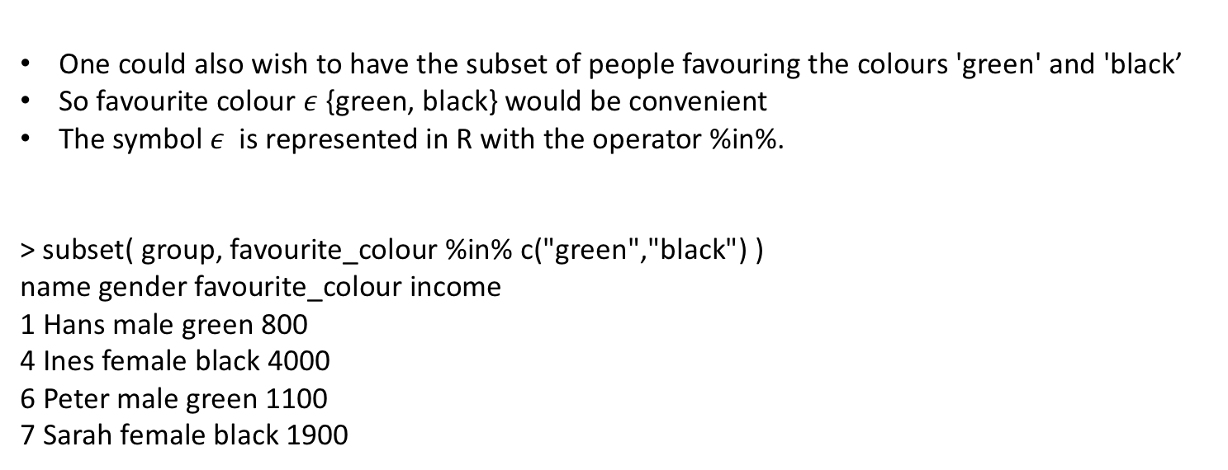
Data frames
One could also wish to have the subset of people favouring the colours 'green' and 'black’
So favourite colour $ε$ {green, black} would be convenient
The symbol $ε$ is represented in R with the operator %in%.
> subset( group, favourite_colour %in% c("green","black") )
name gender favourite_colour income
1 Hans male green 800
4 Ines female black 4000
6 Peter male green 1100
7 Sarah female black 1900

Slide 68
Data frames
Does the subgroup with favourite colour 'yellow' have more income?
We calculate the sample mean of the 'yellow’-group income, which turns out to be higher
Of course, this does not answer the question as the sample size is way too small to have a significant result.
> yellow_group <- subset(group,favourite_colour=="yellow")
> mean(yellow_group$income)
[1] 2649.5
> subset( group, favourite_colour %in% c("green","black") )$income
[1] 800 4000 1100 1900
> mean( group$income )
[1] 2047.429
> mean( subset(group,favourite_colour != "yellow")$income )
[1] 1806.6
> mean( subset(group,favourite_colour %in% c( "green","blue","black"))$income )
[1] 1806.6 # equivalent to previous command

Slide 69
Data frames
You can split a data frame into a list of the respective subgroups
For example we split 'group’ according to 'favourite colour’
This is done with split() which returns a list of data frames.
The command unsplit() reverses this and merges a list of data frames together into a single data frame.
> L <- split(group, group$favourite_colour)
> L # L is a list of data frames
$black
name gender favourite_colour income
4 Ines female black 4000
7 Sarah female black 1900
$blue
name gender favourite_colour income
2 Caro female blue 1233
…

Slide 70
Data frames
If you wish to extend your data frame, then merge() might help you. Here is an example
> snd_colour <- data.frame(favourite_colour=c("green","blue","yellow"),
+ second_colour=c("red","yellow","brown"))
> merge(group,snd_colour,all.x=TRUE)
favourite_colour name gender income second_colour
1 black Ines female 4000 <NA>
2 black Sarah female 1900 <NA>
3 blue Caro female 1233 yellow
4 green Hans male 800 red
5 green Peter male 1100 red
6 yellow Lars male 2400 brown
7 yellow Samira female 2899 brown
Note that everyone with favourite colour=="green" has second colour=="red" . The colour
"black" is not associated with any colour, so the respective entries in the merged data frame
remain NA . For more on merge(), see ?merge.

Slide 71
NA, Inf, NaN, NULL
Data sets are often not complete
There might be values which are simply not known
These missing values are recorded as NA (= not available)
R deals quite well with missing data.
Many commands have arguments to tell the command how to deal with NAs
The command for missing values is is.na()
> v <- c( 1,3,NA,5 )
> v[1] <- NA
> v
[1] NA 3 NA 5
> is.na(v)
[1] TRUE FALSE TRUE FALSE

Slide 72
NA, Inf, NaN, NULL
> 5*v
[1] NA 15 NA 25
> v*NA
[1] NA NA NA NA
> sum(v)
[1] NA
> is.na(v)==FALSE
[1] FALSE TRUE FALSE TRUE
> w1 <- v[is.na(v)==FALSE] # remove all missing values from the vector
> w1
[1] 3 5
> w2 <- v[!is.na(v)] # same as w1

Slide 73
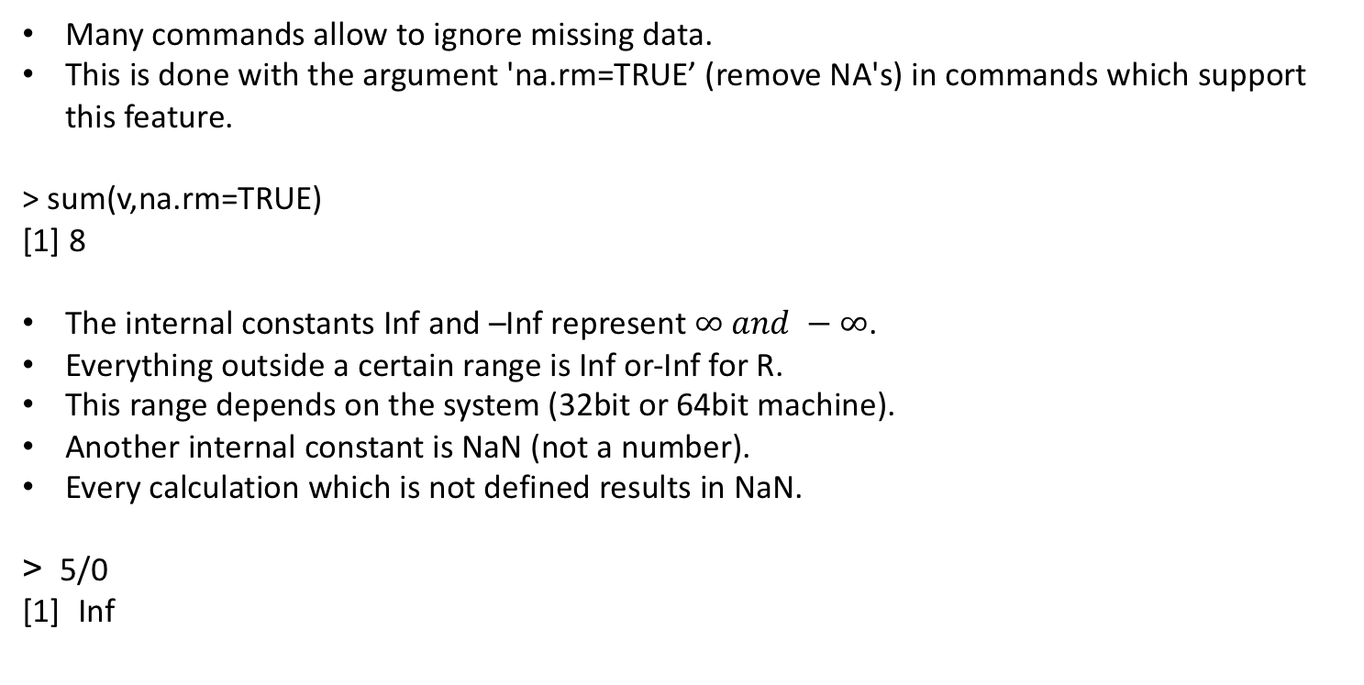
NA, Inf, NaN, NULL
Many commands allow to ignore missing data.
This is done with the argument 'na.rm=TRUE’ (remove NA's) in commands which support this feature.
> sum(v,na.rm=TRUE)
[1] 8
The internal constants Inf and –Inf represent $∞ and −∞$.
Everything outside a certain range is Inf or-Inf for R.
This range depends on the system (32bit or 64bit machine).
Another internal constant is NaN (not a number).
Every calculation which is not defined results in NaN.
> 5/0
[1] Inf

Slide 74
NA, Inf, NaN, NULL
> Inf*(-2)
[1] –Inf
> Inf*Inf
[1] Inf
> 0/0
[1] NaN
'NULL' represents the null object (represents 'there is no object') in R
NULL is often returned by functions and expressions whose value is undefined
So NaN is an undefined numeric value and NULL is often used as undefined object

Slide 75
Exercise 2

Slide 76
Reading and writing data frames
Read a data frame from a file with read.table().
Write a data frame to a file with write.table().
Typical call:
read.table(file=”filename.txt ",header=TRUE) # Now you know about paths
write.table(dataframe , file=”your_file.txt ")
Before reading your first data from a file into a data frame, you need to prepare them.
You need to think about columns and separators. Your data could look as follows:
weight smoker lifespan
3 0 50.5
3 0 52.8
3 1 54.7
3 0 56.0

Slide 77
Reading and writing data frames
Now start Excel and open a new table.
Enter the data as in the above table.
Then store the file as text file with the tabulator as delimiter: File/Save as/...
Then from the 'Save as type' options choose 'Text (Tab delimited)’
Store the file for example as ‘example'. Excel automatically adds the extension '.txt' for text files.
Make sure that the file is in the current working directory.
Use the menu (File/change directory) or getwd() and setwd() to determine and set the working directory.
Then you read the file with the command read.table().
The first line of the file contains the names of the variables and is called 'header', so we specify the option 'header=TRUE'.

Slide 78
Reading and writing data frames
> setwd("D:/Rcourse/") # "" are necessary. Note / instead of \
> riscfactor <- read.table(file="lifespandata.txt",header=TRUE)
> # Alternatively use file.choose() (the choose-file-menu pops up in a GUI):
> # riscfactor <- read.table(file=file.choose(),header=TRUE)
> riscfactor
weightcls smoker lifespan
1 1 0 50.5
2 2 0 52.8
3 2 1 54.7
4 1 0 56.0

Slide 79
Reading and writing data frames
> str(riscfactor)
'data.frame' : 12 obs. of 4 variables:
$ weightcls : int 3 3 3 3 2 2 2 2 1 1 ...
$ smoker : int 0 0 1 0 0 1 0 0 1 0 ...
$ lifespan : num 50.3 52.8 54.7 56
> write.table(riscfactor,file=”exampleout.txt")

Slide 80
Reading and writing data frames
It is important to learn how to put your data into the data or Excel spreadsheet. There
are countless ways of doing it but only one way which makes life easy later
The key thing to remember is that all the values of the same variable go in the SAME COLUMN
Here is an example. If you had an experiment with three treatments (control, pre-heated, prechilled), and four measurements per treatment, it might seem like a good idea to create the spreadsheet like this:
However this is not ideal for handling the data with R. The good way to enter these data is to
have one column for the response variable and one column which indicates the treatment.
Control | Pre-heated | Pre-chilled
6.1 | 6.3 | 7.1
5.9 | 6.2 | 8.2
5.8 | 5.8 | 7.3
5.4 | 6.3 | 6.9

Slide 81
Reading and writing data frames
Response | Treatment
6.1 | Control
5.9 | Control
5.8 | Control
5.4 | Control
6.3 | Pre-heated
6.2 | Pre-heated
5.8 | Pre-heated
6.3 | Pre-heated
7.1 | Pre-chilled
8.2 | Pre-chilled
7.3 | Pre-chilled
6.9 | Pre-chilled
The good way to enter these data is to have one column for the response variable and one column which indicates the treatment
This organization of the data is more suitable for R as R is particularly good in grouping a vector (here 'Response') according to a criterion (here 'Treatment').

Slide 82
Reading and writing data frames
The following two lists explain important options of read.table() and of write.table() in more
detail.
header: a logical value indicating whether the le contains the names of the variables as its first
line. If missing, the value is determined from the le format: 'header' is set to 'TRUE’ if and only if the first row contains one fewer field than the number of columns.
sep: the field separator character. Values on each line of the file are separated by this character. If 'sep = ""' (the default for 'read.table') the separator is 'white space', that is one or more spaces, tabs, newlines or carriage returns.

Slide 83
Reading and writing data frames
write.table(x, file="", append=FALSE, quote=TRUE, sep=" ",...)
x: the object to be written, preferably a matrix or data frame. If not, it is attempted to
coerce 'x' to a data frame.
file: a character string naming a le for writing. '""' indicates output to the console.
append: logical. If 'TRUE', the output is appended to the le. If 'FALSE', any existing le of
the name is destroyed. So be careful.
quote: a logical value ('TRUE' or 'FALSE') or a numeric vector. If 'TRUE', any character or
factor columns will be surrounded by double quotes. If a numeric vector, its elements
are taken as the indices of columns to quote. In both cases, row and column names
are quoted if they are written. If 'FALSE', nothing is quoted.
sep: the eld separator string. Values within each row of 'x' are separated by this string.
row.names: either a logical value indicating whether the row names of 'x' are to be written along with 'x', or a character vector of row names to be written.

Slide 84
Reading and writing data frames
There are short-cuts for different types of input which save typing. Here is a list which
species the defaults for the different commands.
You can also input data from clipboard. Try to copy something from excel and read it in R without read.table but pipe(“pbpaste”).
Command | header | sep | dec | fill
read.table() | FALSE | "" | "." | FALSE
read.csv() | TRUE | "," | "." | TRUE
read.csv2() | TRUE | ";" | "," | TRUE
read.delim() | TRUE | ” \t" | "." | TRUE
read.delim2() | TRUE | ” \t" | "," | TRUE

Slide 85
Examples of different input files
Before reading in an input file, you should open the data file in order to find out its format.
Example 1: First three lines of the file are:
wghtcls smoker lifespan
3 0 50.3
3 0 52.8
Example 2: First three lines of the file are:
wghtcls,smoker,lifespan
3,0,50.3
3,0,52.8
Two R commands doing the same:
> riscfactor <- read.csv(”example.csv")
> riscfactor <- read.table(”example.csv",header=TRUE,sep=",",fill=TRUE)

Slide 86
Factors
In the data frame 'riscfactors', the values of 'weightcls' are of type 'numeric’
However, the values '1', '2' and '3' in the vector 'weightcls' are intended to be names of different groups rather than true numerical values
This does make a difference to R so we need to tell R what our intention is. This is done with factor(). The command levels() returns the names of the different groups in a factor.
Note the different behaviour of str() and of summary() according to whether the argument is a numeric vector or a factor.
> x <- c("female","male","male","female","female")
> levels(x)
NULL

Slide 87
Factors
> x <- factor(x)
> levels(x)
[1] "female" "male"
> str(x)
Factor w/ 2 levels "female","male": 1 2 2 1 1
> y <- rep(c(17,17,18),4); str(y)
num [1:12] 17 17 18 17 17 18 17 17 18 17 ...
> summary(y)
Min. 1st Qu. Median Mean 3rd Qu. Max.
17.00 17.00 17.00 17.33 18.00 18.00
> y <- factor(y); str(y)
Factor w/ 2 levels "17","18": 1 1 2 1 1 2 1 1 2 1 ...
> summary(y)
17 18
8 4

Slide 88
Factors
So if numerical values are used as names rather than as true numerical values, then mark the vector as factor.
The following definition of riscfactors2 improves the definition of riscfactors.
> riscfactors2 <- data.frame( weightcls=factor( rep(3:1,c(4,4,4)) ),
+ smoker=factor( rep(c(0,0,1),4) ), lifespan=seq(50,72,2) )
If the column of a data file is a factor, then either specify the class of the columns with “colClasses=“ or convert the variable after reading the data:
> riscfactor <- read.table(”example.txt",header=TRUE,
+ colClasses=c("factor","numeric","numeric"))
> riscfactor <- read.table(”example.txt",header=TRUE)
> class(riscfactor$wghtcls)
[1] "integer"
> riscfactor$wghtcls <- factor(riscfactor$wghtcls)
> class(riscfactor$wghtcls)
[1] "factor"

Slide 89
Conditional execution: if() and ifelse()
Syntax:
if ( condition ) { commands1 }
if ( condition ) { commands1 } else { commands2 }
ifelse ( conditions_vector , yes_vector , no_vector )
The command if() evaluates 'commands1 ' if the logical expression 'condition ' returns TRUE.
Here 'commands1 ' is a single command or a sequence of commands separated with ‘;’
The command if() else() evaluates 'commands1 ' if the logical expression 'condition ' returns TRUE, otherwise it evaluates 'commands2 ‘.
The command ifelse() returns a vector of the same length as 'conditions_vector ' with elements selected from either 'yes_vector ' or 'no_vector ' depending on whether the element of 'conditions_vector ' is TRUE or FALSE.

Slide 90
Conditional execution: if() and ifelse()
What is printed in the following code snippet?
check=2
if(check==1){
print(“Condition evaluated to TRUE”)
}else{
print(“Condition evaluated to FALSE”)
}
> z <- 6:-3
> sqrt(z) # Produces a warning
[1] 2.449490 2.236068 2.000000 1.732051 1.1414214 1.000000 0.000000 NaN
[9] NaN NaN
Warning message:
In sqrt(z) : NaNs
> sqrt( ifelse( z>=0, z, NA ) ) # No warning
[1] 2.449490 2.236068 2.000000 1.732051 1.414214 1.000000 0.000000 NA
[9] NA NA

Slide 91
Loops: for(), while() and repeat()
Syntax:
for ( var in set ) { commands }
while ( condition ) { commands }
repeat { commands }
The object set is a vector, commands is a single command or a sequence of commands and var is a variable which may be used in commands. The command for() is the R version of 'for
element in the set do ...’.
The command while() is the R version of 'as long as the condition is TRUE do ...’.
The command repeat() is the R version of 'repeat until I say break’.
The command 'break ' stops any loop; control is then transferred to the first statement outside the loop.
The command 'next ' halts the processing of the current iteration and advances the looping index.

Slide 92
Loops: for(), while() and repeat()
> x <- 0
> for ( i in 1:5 ) { if (i==3) { next } ; x <- x + i }
> x # i=3 is skipped, so x <- 1+2+4+5
[1] 12
> y <- 1; j <- 1
> while ( y < 12 & j < 8 ) { y <- y*2 ; j <- j + 1}
> y; j
[1] 16
[1] 4
> z <- 3
> repeat { z<- z^2; if ( z>100 ) { break }; print(z)}
[1] 9
[1] 81
> z # the loop stopped after 81^2, so z==81^2
[1] 6561

Slide 93
Examples
Let us approximate the mean of a dice. We use the command sample() for simulating a dice.
The command sample(v,n,replace=TRUE) produces a sample (random draw) of length n from the vector v with replacement.
> x<-sample(1:6,1000,replace=TRUE)
> mean(x)
[1] 3.469
Iterative assessment of t-test.
> counter <- 0
for( i in 1:10000) {
if( t.test(rnorm(100),rnorm(100))$p.value <= 0.05 ) {
counter <- counter + 1
}
}
> counter/10000
[1] 0.0497

Slide 94
Exercise
What’s the output of the following code?
for(i in 1:39){
if(i < 21){
print(1:i)
}else{
print(1:(40 - i))
}
}

Slide 95
Executing commands from a script
Instead of typing commands in R it is often more convenient to type the commands into a file and then execute the file with R.
Files with R commands are called R scripts and are usually given the extension '.R' (or '.r') although this is not necessary.
You execute an R script with the command source().
The argument for source() is the filename of the script (the name must be quoted)

Slide 96
Executing commands from a script
Now we execute the script.
> source(”path_to_my_script")
If you wish to avoid entering the pathname in the command source() and if 'myscript.R' is in the current working directory, then it suffices to say source("myscript.R").
If you are unsure, what the current working directory is, use the command getwd().
You may change the current working directory with setwd().

Slide 97
Executing commands from a script – usual errors
It is very important to learn how to understand the errors (that is applicable to every programming language)
> source("myscript.R")
Error in file(file, "r", encoding = encoding) :
cannot open connection
Additional warning:
In file(file, "r", encoding = encoding) :
cannot open file 'myscript.R': No such file or directory
# myscript.R does not exist? Probably wrong working directory. Let's check.
> getwd()
[1] "C:/Documents/")
> setwd("C:/Documents/R") # We need to change the working directory
> getwd()
[1] "C:/Documents/R")
> list.file(“.”, pattern=“.R”) # Show all files in the current directory
[1] "somepdffile.pdf" "myscript.R" "otherscript.R"

Slide 98
Writing your own functions
Syntax:
myfun <- function ( arg1, arg2, …) {commands}
This defines a function with name myfun .
The function arguments arg1 , arg2 , … are then processed with the sequence of commands commands .
Use the command return() for returning a value. If you need to return several values put them into a list and return the list.
Being defined the function can be called as myfun(expr1,expr2,...) where expr1 , expr2 ,… are expressions whose values are assigned to the respective argument in the definition of the function.

Slide 99
Writing your own functions
> se <- function(x)
+ {
+ y<-sqrt(var(x)/length(x))
+ return(y)
+ }
> se(1:4)
[1] 0.6454972
> se("wrong type of argument")
[1] NA
Warning message:
In var(x) : NAs introduced by coercion

Slide 100
Writing your own functions
In case of an error (e.g. wrong type of arguments), use the command stop("errormsg" ) to stop the execution of the function and to return the error message 'errormsg ‘.
Improved version:
> se <- function(x)
+ {
+ if (is.numeric(x)!=TRUE)
+ {
+ stop("need numeric data")
+ }
+ y<-sqrt(var(x)/length(x))
+ }
> se(1:4)
[1] 0.6454972
> se("wrong type of argument")
Error in se("wrong type of argument") : need numeric data

Slide 101
Writing your own functions
In many cases arguments can be given commonly appropriate default values, in which case they may be omitted from the call when the defaults are appropriate. Improved version:
> se <- function(x, na.rm=FALSE)
+ {
+ if (is.numeric(x)!=TRUE)
+ {
+ stop("need numeric data")
+ }
+ if (na.rm==TRUE)
+ {
+ x<-x[is.na(x)==FALSE]
+ }
+ y<-sqrt(var(x)/length(x))
+ }
> se(c(NA,1:4))
[1] NA
> se(c(NA,1:4),na.rm=TRUE)
[1] 0.6454972

Slide 102
Writing your own functions
The arguments in the call se(c(NA,1:4),TRUE) are assigned to the variables of se() in the order specified by the definition of se() .
Remembering this order of arguments is often inconvenient. The order of arguments does not matter if you reference by name, that is, if you specify arguments in the form 'name=object ‘.
Furthermore there may be both unnamed and named arguments.

Slide 103
Writing your own functions
Another feature of R is the '. . . ' argument. Thereby one can pass on arguments from one
function to another function.
> se.sq <- function(x, ... )
+ {
+ y <- se( x, ... )
+ return(y^2)
+ }
Whatever is assigned to the '...' argument is put into the argument list of se() .
> se.sq(1:4)
[1] 0.4166667
> se.sq(c(NA,1:4))
[1] NA
> se.sq(c(NA,1:4),na.rm=TRUE)
[1] 0.4166667

Slide 104
Writing your own functions
If you want to return several values, then return them as vector or as list.
Here is an example which returns the condence interval of the mean of a sample based on the normal approximation.
> ci.norm <- function(x, conf=0.95)
+ {
+ q <- qnorm(1-(1-conf)/2)
+ return( list(lower=mean(x)-q*se(x),upper=mean(x)+q*se(x)) )
+ }
> ci.norm(rnorm(100))
$lower
[1] -0.149955
$upper
[1] 0.2754680
> ci.norm(rnorm(100),conf=0.99)
$lower
[1] -0.1673693
$upper
[1] 0.2443276

Slide 105
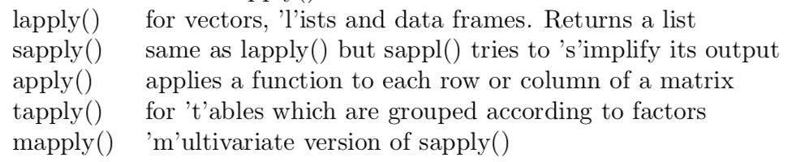
The commands lapply() and tapply()
The command apply() and its relatives apply a function to each element of the specified object. Here are the relatives of apply().

Slide 106
The commands lapply() and tapply() - Examples
> v <- 1:4
> lapply(v,factorial) # returns list
[[1]]
[1] 1
[[2]]
[1] 2
[[3]]
[1] 6
[[4]]
[1] 24
> sapply(v,factorial) # returns a vector
[1] 1 2 6 24

Slide 107
The commands lapply() and tapply()
> L <- list(0:3, 5:8, -1:2)
> lapply(L,mean) # mean of each vector in the list
[[1]]
[1] 1.5
[[2]]
[1] 6.5
[[3]]
[1] 0.5
> sapply(L,mean)
[1] 1.5 6.5 0.5

Slide 108
The commands lapply() and tapply()
> m <- cbind(0:3, 5:8, -1:2) ; m
[,1] [,2] [,3]
[1,] 0 5 -1
[2,] 1 6 0
[3,] 2 7 1
[4,] 3 8 2
> apply(m,2,mean) # apply ’mean’ to each column ; 2 for second margin
[1] 1.5 6.5 0.5
> apply(m,1,mean) # apply ’mean’ to each row; 1 for first margin
[1] 1.333333 2.333333 3.333333 4.333333

Slide 109
The commands lapply() and tapply()
The command tapply() is typically applied to data frames
Consider the following data frame.
Each individual is either smoker or non-smoker and belongs to one the
three weight classes 1, 2 or 3.
> riscfactors <- data.frame( weightcls=rep( 3:1,c(4,4,4) ),
+ smoker=rep(c(0,0,1),4), lifespan=seq(50,72,2) )
weightcls smoker lifespan
3 0 50
2 3 0 52
3 3 1 54
4 3 0 56
5 2 0 58
6 2 1 60
7 2 0 62
8 2 0 64
9 1 1 66
10 1 0 68
11 1 0 70
12 1 1 72

Slide 110
The commands lapply() and tapply()
What is the influence of the two risk factors ’weight’ and ’smoking’ on the average
life span?
For example we could calculate the average lifespan for smokers and non-smokers in our
self-generated data. This could be done as follows.
> mean( lifespan[ smoker==0 ] )
[1] 60
> mean( lifespan[ smoker==1 ] )
[1] 63
However this becomes inconvenient if the factor has many values
tapply() applies the function ’mean’ to the two subvectors of lifespan which are determined by the vector ’smoker’
> tapply(lifespan,smoker,mean)
0 1
60 63

Slide 111
Exercise 3

Slide 112
Generating and manipulating strings
Here is an overview of commands which generate or manipulate strings. For the syntax details, see the respective help pages.
function | Description
format() | Format an R object for pretty printing
grep(), grepl() | Find a substring
charmatch() | Returns positions of matches
nchar() | Count the number of characters
paste() | Concatenate strings after conversion
strsplit() | Split string at given delimiter
gsub() | Substitute a substring by another string
substring() | Return a substring between given positions
toupper | Translate lower-case into upper-case characters
tolower() | Translate upper-case into lower-case characters

Slide 113
Examples
> s <- paste("Diet",1:8); s # adds one space between the arguments by default
[1] "Diet 1" "Diet 2" "Diet 3" "Diet 4" "Diet 5" "Diet 6" "Diet 7" "Diet 8"
> s <- paste("grey",2:10,"0",sep=""); s
[1] "grey20" "grey30" "grey40" "grey50" "grey60" "grey70" "grey80"
[8] "grey90" "grey100"
> nchar("Number?")
[1] 7
> nchar(s)
[1] 6 6 6 6 6 6 6 6 7
> u <- toupper(s) ; u
[1] "GREY20" "GREY30" "GREY40" "GREY50" "GREY60" "GREY70" "GREY80"
[8] "GREY90" "GREY100"
> substring("abcdef",first=2,last=4)
[1] "bcd"

Slide 114
Exercise
Define the following string:
> a <- “A*01:01:03:08N”
Imagine we have another vector where HLA names are like “hla_a_01_01_03” and we want to match the two strings
Aim: Use functions from the previous slide to alter a

Slide 115
grep() family and regular expressions
> grep("rey",s)
[1] 1 2 3 4 5 6 7 8 9
> grep("rey",s,value=T)
[1] "grey20" "grey30" "grey40" "grey50" "grey60" "grey70" "grey80"
[8] "grey90" "grey100"
expression | Description
. | Matches any single character
[abd] | Matches any single character in the list, here a, b or d
[^abd] | Matches any single character except those in the list
[b-s] | Matches any single character between b and s
* | The preceding item will be matched 0 or more times
+ | The preceding item will be matched 1 or more times
? | The preceding item will b ematched 0 or 1 time
{n,} | The preceding item will be matched n or more times
^ | Matches the beginning of the string
$ | Matches the end of the string

Slide 116
Examples
> s <- colors()
> grep("gr[ea]y",s) # any color with ’grey’ or ’gray’ in it
> grep("gr[ea]y",s,value=T)
> grep("gr[ea]y$",s,value=T) # any color which ends on ’gr[ea]y’
> grep("^gre",s,value=T) # any color which starts with ’gre’
> grep("^gre.*[^0-9]$",s,value=T) # starts with ’gre’ and ends with a letter
> grep("green|yellow",s,value=T) # any color with ’green’ or ’yellow’ in it

Slide 117
Exercise
Go to “exercises/bam_dir” directory
Aim: Using list.files() get the number of files whose name finishing in “.bam” and those finishing in “.bai”
Steps:
Define the path where bam_dir is
Check help for list.files()
Use paths and pattern to fill list.files() arguments

Slide 118
Data wrangling with dplyr and tidyr

Slide 119
Data manipulation: advanced topics (dplyr & tidyr)
> install.packages(“tidyr”) # install packages
> install.packages(“dplyr”)
%>% operator
> filter(data, variable==numeric_value)
# OR
> data %>% filter(variable==numeric_value) # piping
All of the functions I showed you so far can be used with pipes
> data %>% subset(variable==numeric_value)
> data %>% head
> data %>% str

Slide 120
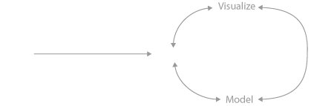
Data wrangling

Slide 121
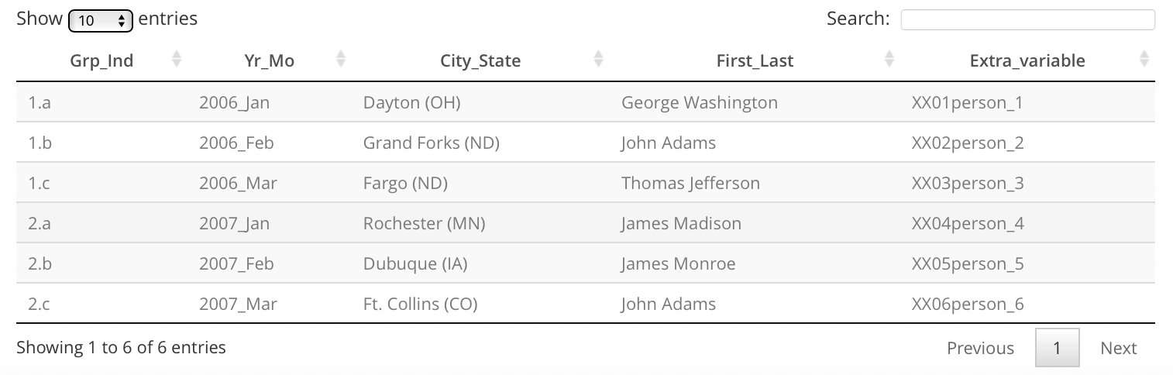
Cleaning, preparing and summarizing data
Up to 80% of data analysis is spent on the process of cleaning and preparing data

Slide 122
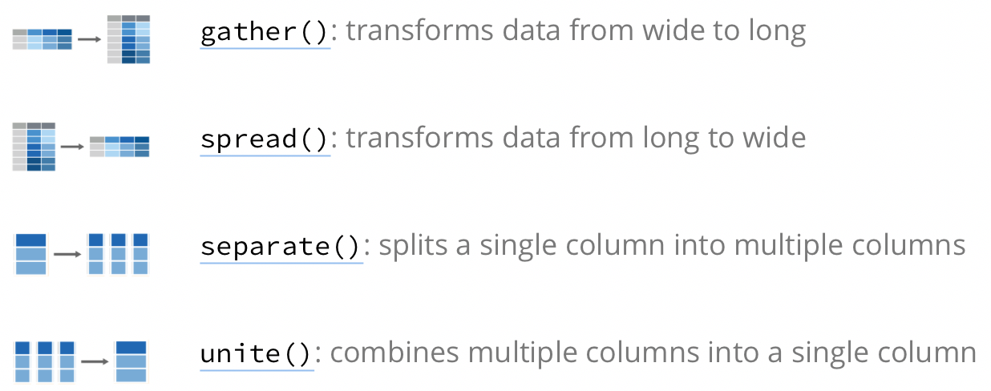
tidyr: primary functions
http://rpubs.com/bradleyboehmke/data_processing

Slide 123
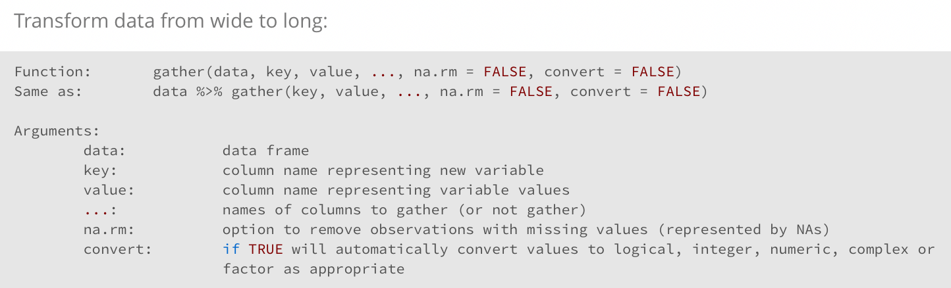
tidyr: primary functions

Slide 124
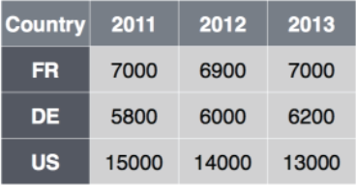
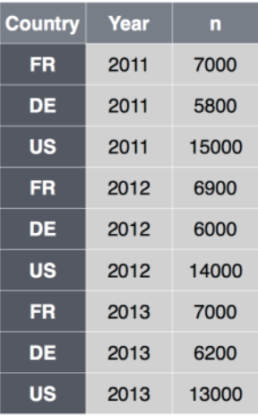
tidyr: primary functions
Name of the new “value” variable
cases %>% gather(Year, n, 2:4)
Name of the new “key” variable
Columns to
collapse

Slide 125
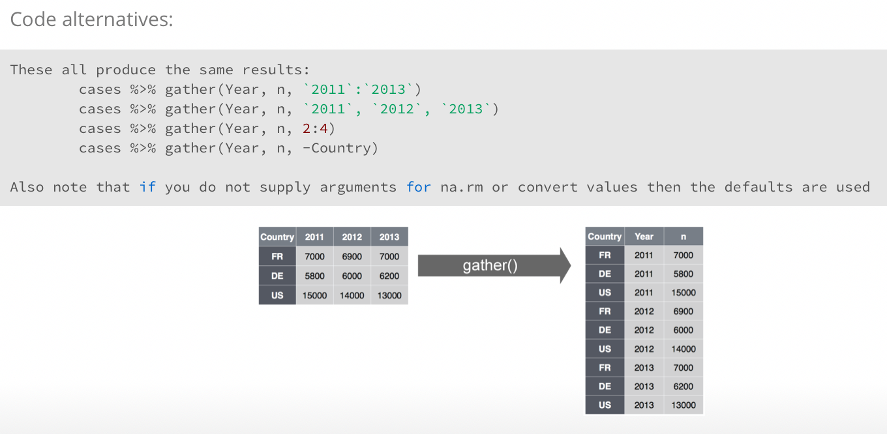
tidyr: primary functions

Slide 126
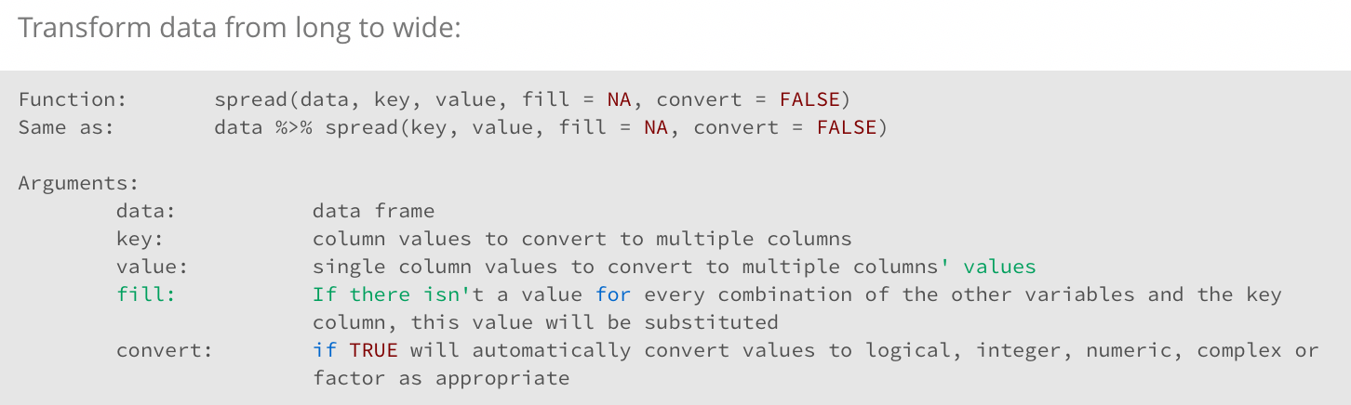
tidyr: primary functions

Slide 127
tidyr: primary functions
cases %>% spread(Year, n)

Slide 128
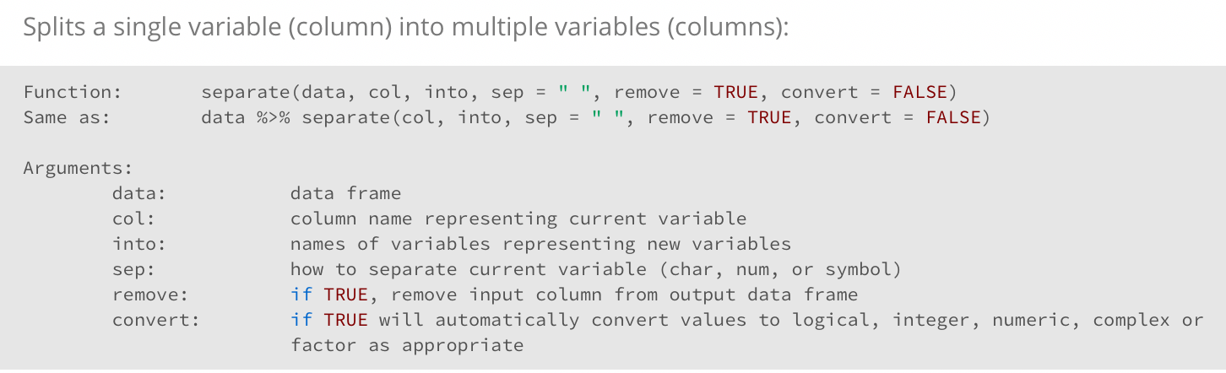
tidyr: primary functions

Slide 129
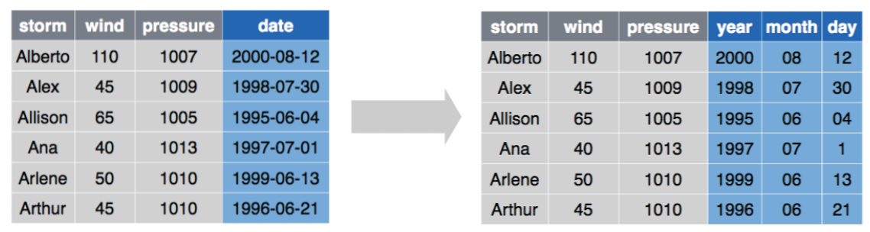
tidyr: primary functions
storms %>% separate(date, into=c(“year”, “month”, “day”), sep=“-”)

Slide 130
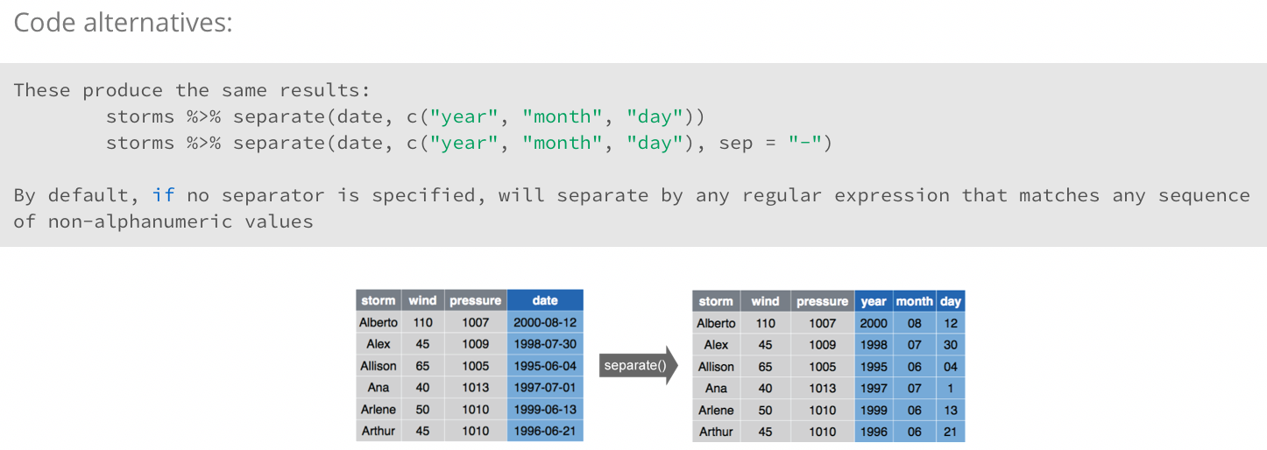
tidyr: primary functions

Slide 131
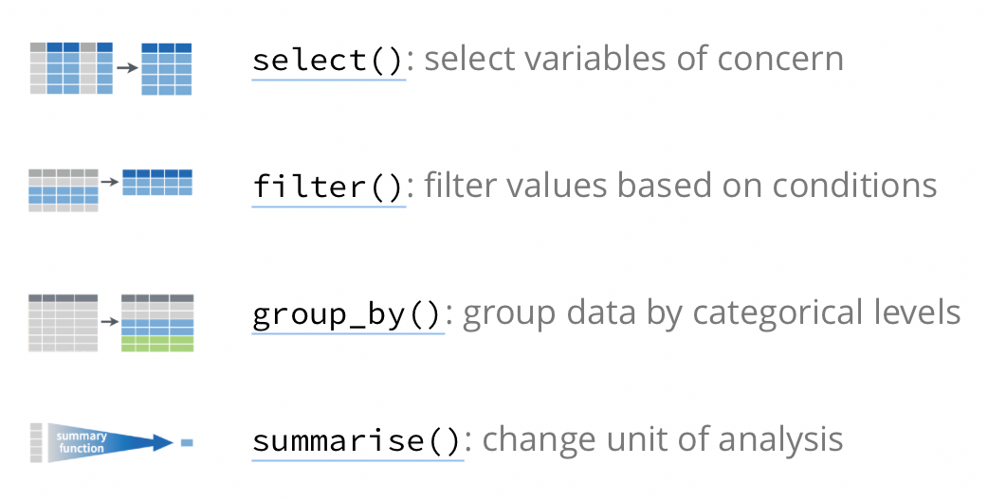
dplyr: primary functions
http://rpubs.com/bradleyboehmke/data_processing

Slide 132
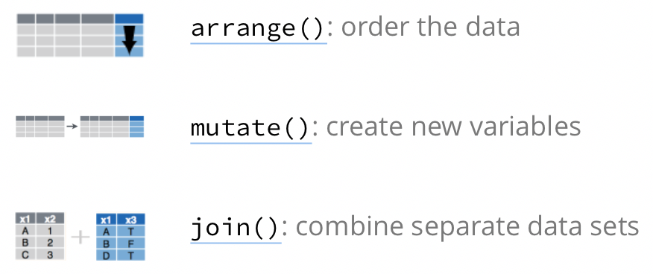
dplyr: primary functions
http://rpubs.com/bradleyboehmke/data_processing

Slide 133
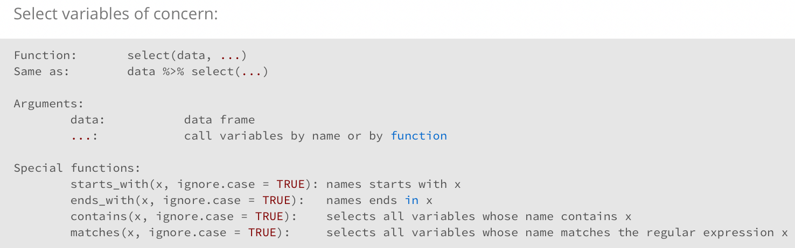
dplyr: primary functions

Slide 134
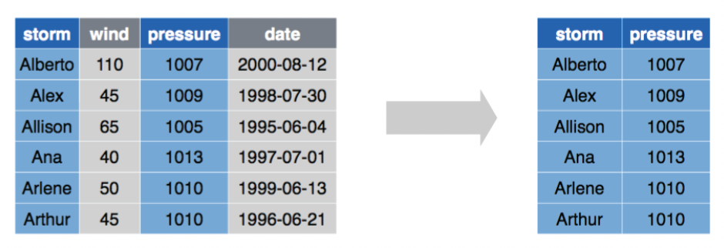
dplyr: primary functions
storms %>% select(storm, pressure)

Slide 135
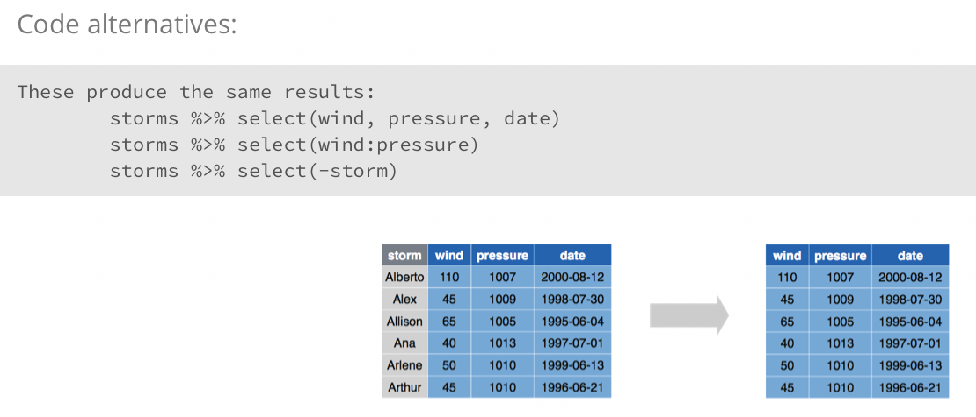
dplyr: primary functions

Slide 136
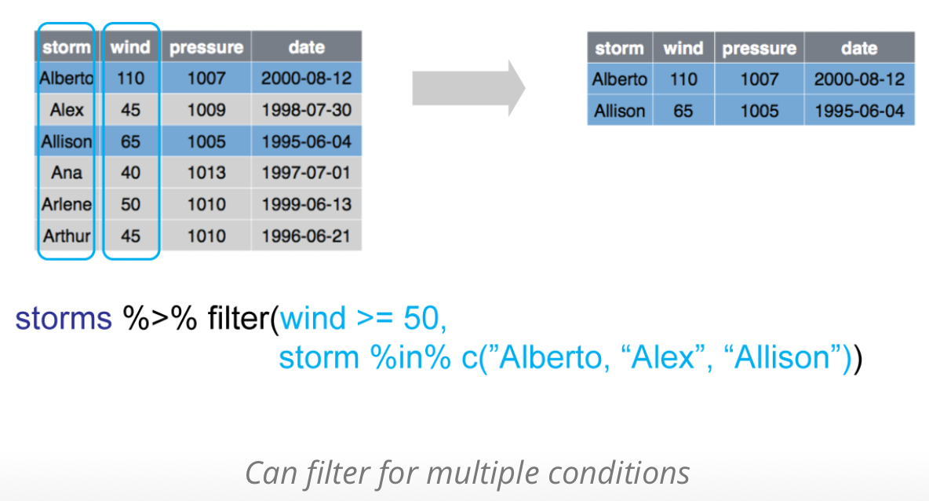
dplyr: primary functions

Slide 137
dplyr: primary functions
All logical operators you know so far can be used within filter()
operator | Description
<, > | less, greater than
== | equal to
!= | not equal to
<=, >= | less/greater or equal to
is.na | is NA
!is.na | is not NA
&, |, ! | Boolean operators

Slide 138
dplyr: primary functions
Other subsetting functions:
function | Description
storms %>% distinct() | Remove duplicate rows
storms %>% sample_frac(0.5, replace=T) | Randomly select fraction of rows
storms %>% sample_n(10, replace=T) | Randomly select n rows
storms %>% slice(3:5) | Select rows by position
storms %>% head(n=5) | Select top n entries
storms %>% tail(n=5) | Select bottom n entries

Slide 139
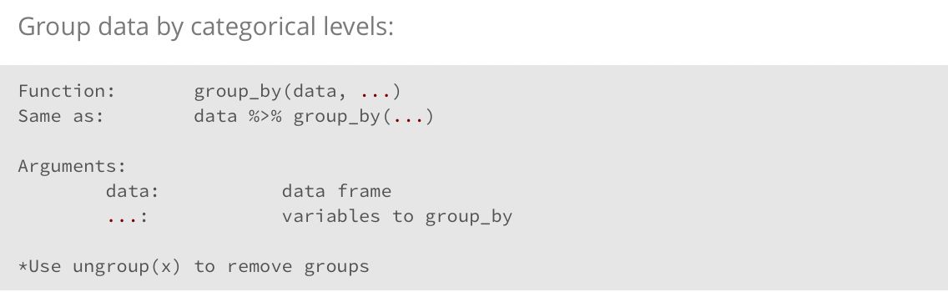
dplyr: primary functions

Slide 140
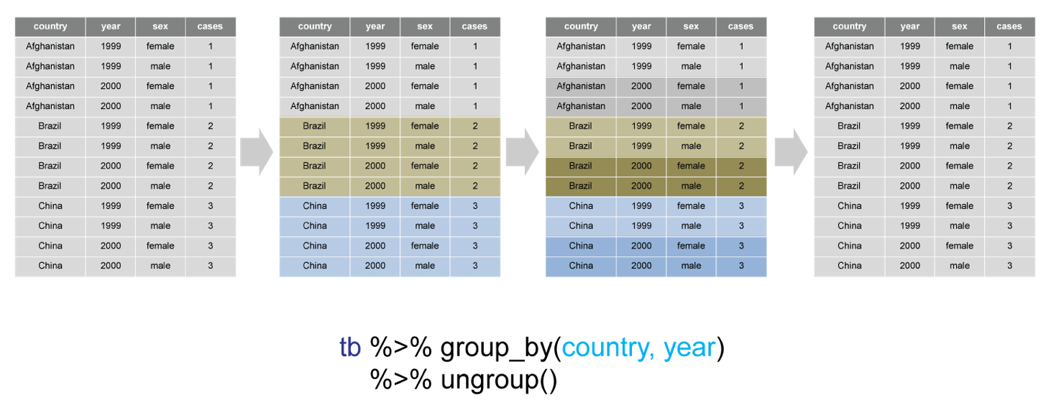
dplyr: primary functions

Slide 141
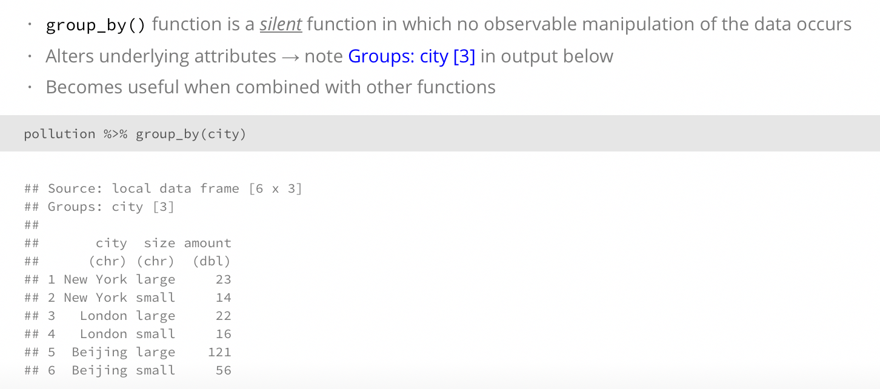
dplyr: primary functions

Slide 142
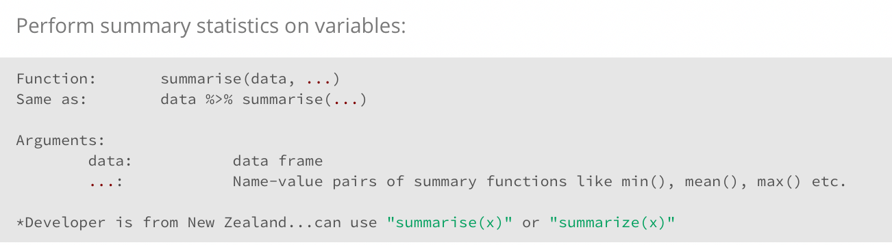
dplyr: primary functions

Slide 143
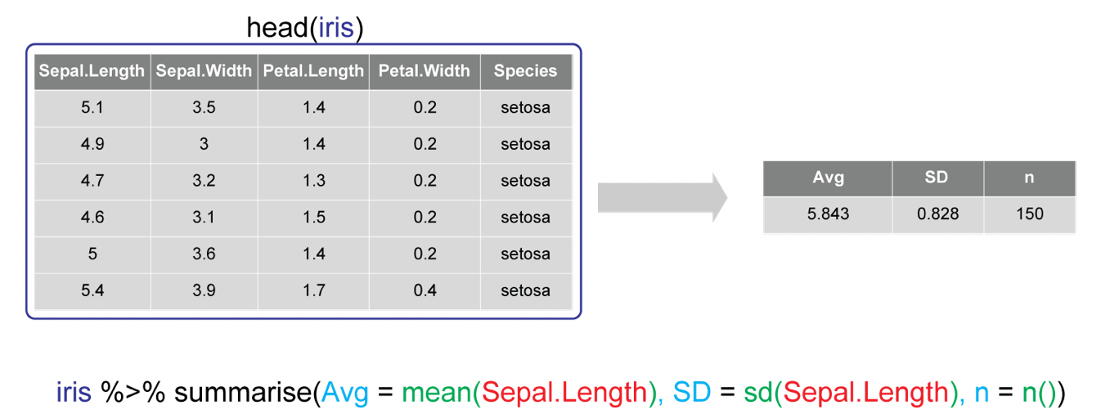
dplyr: primary functions

Slide 144
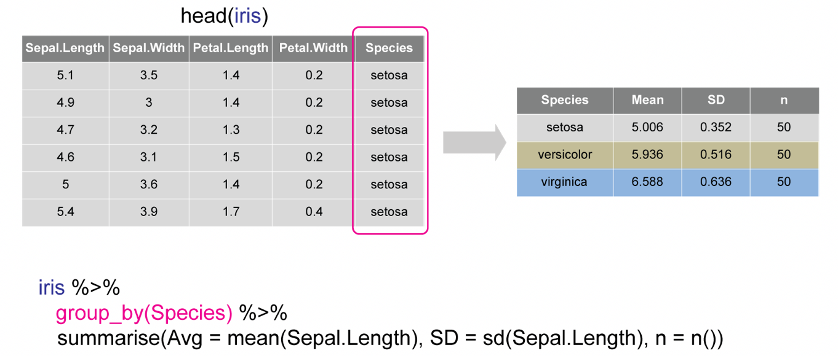
dplyr: primary functions

Slide 145
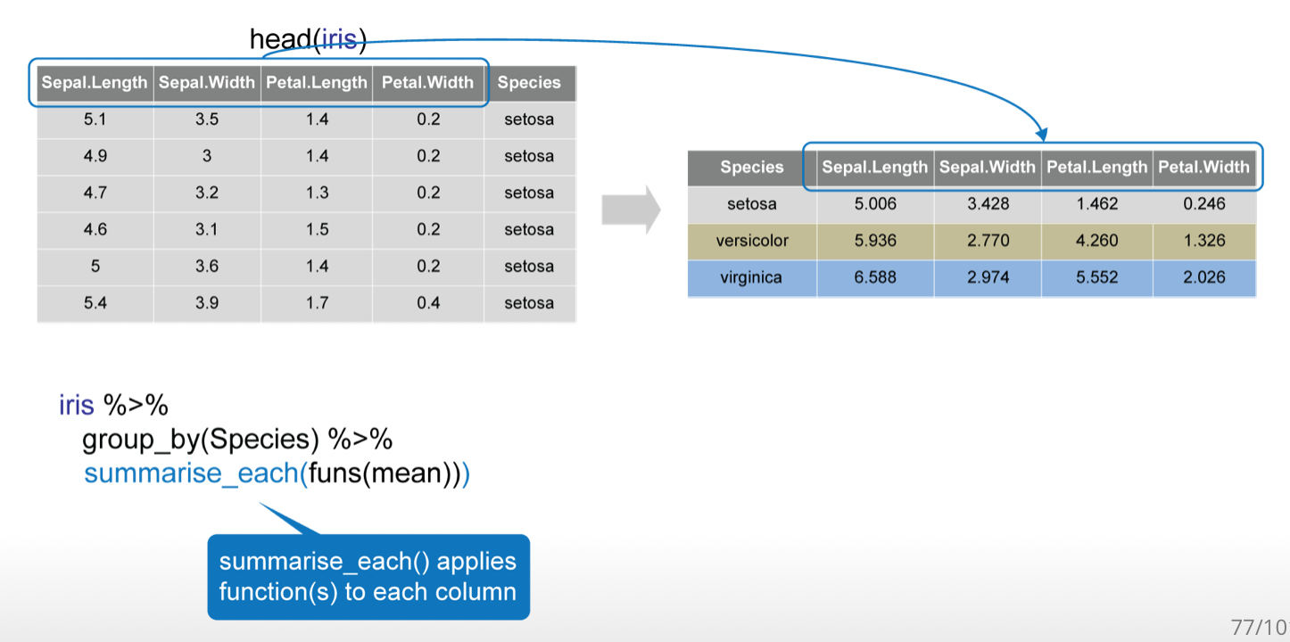
dplyr: primary functions

Slide 146
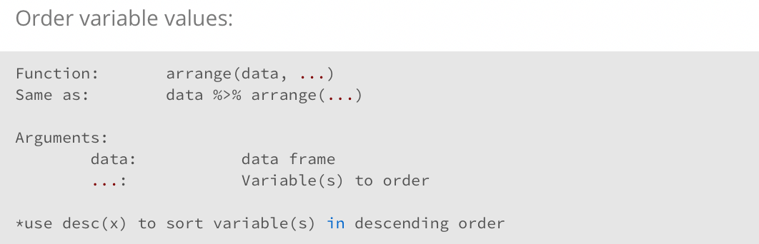
dplyr: primary functions

Slide 147
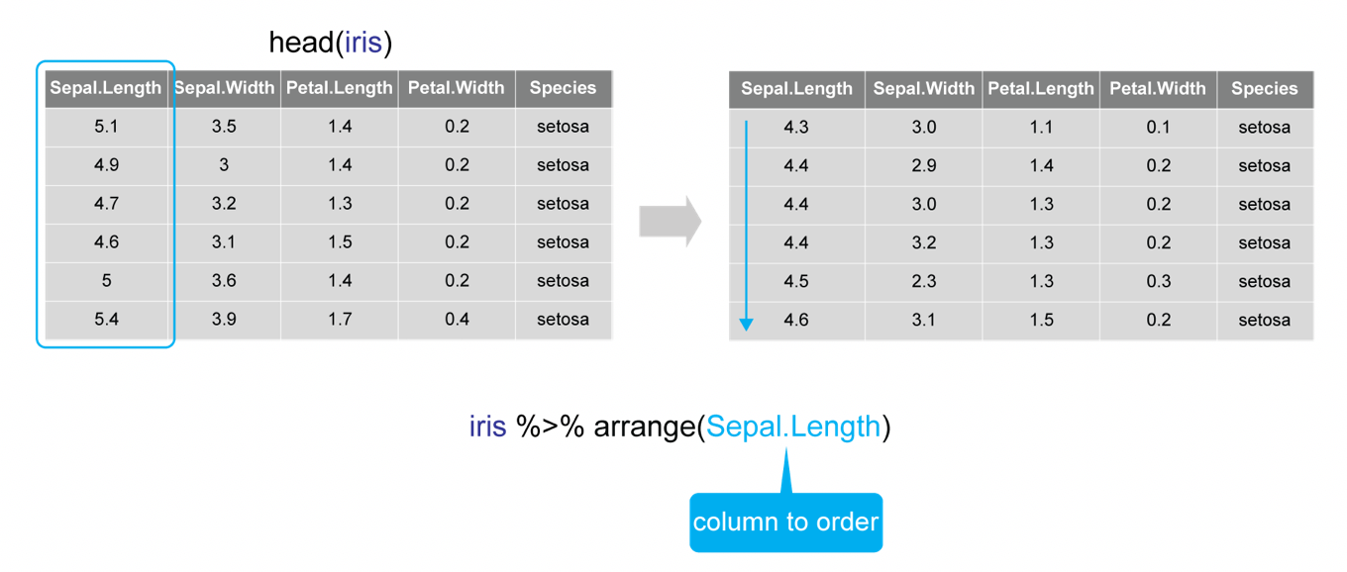
dplyr: primary functions

Slide 148
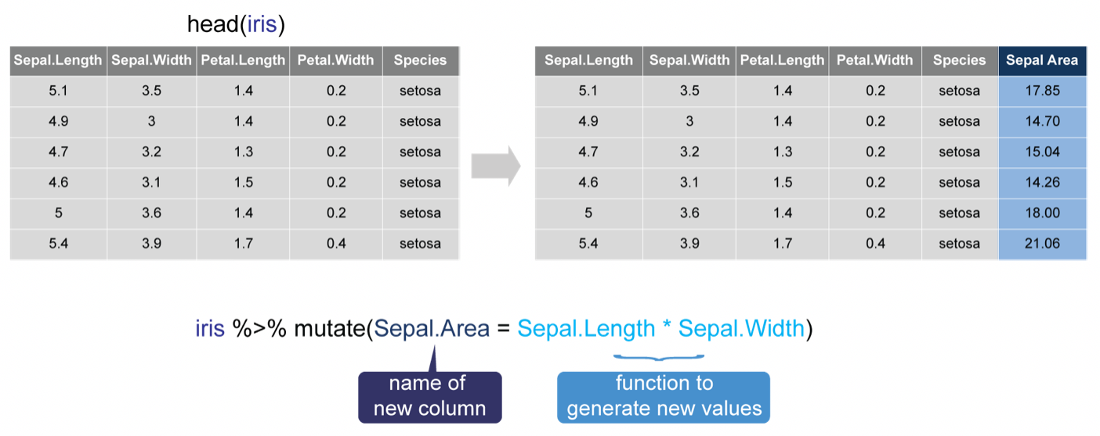
dplyr: primary functions

Slide 149
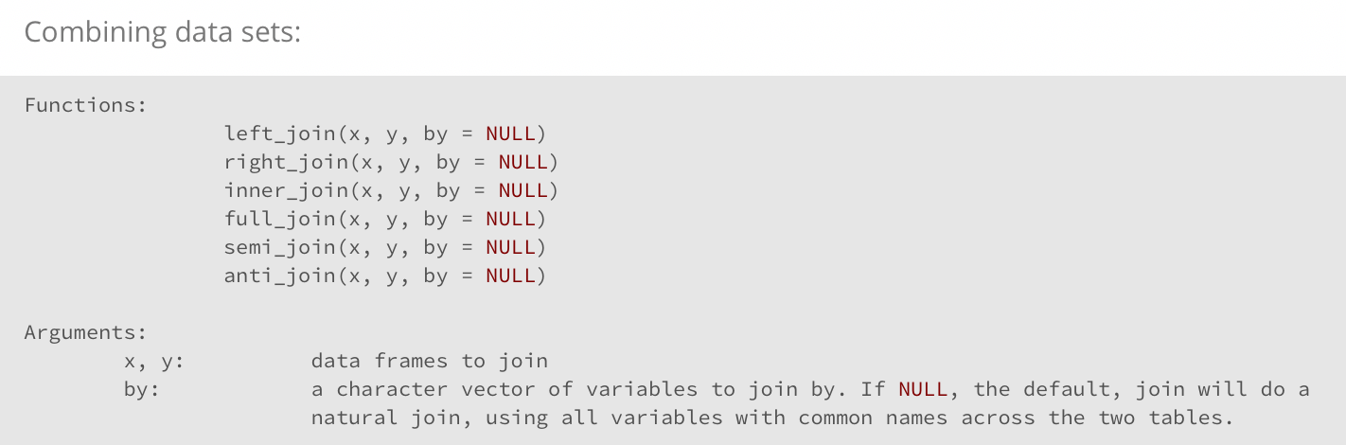
dplyr: primary functions

Slide 150
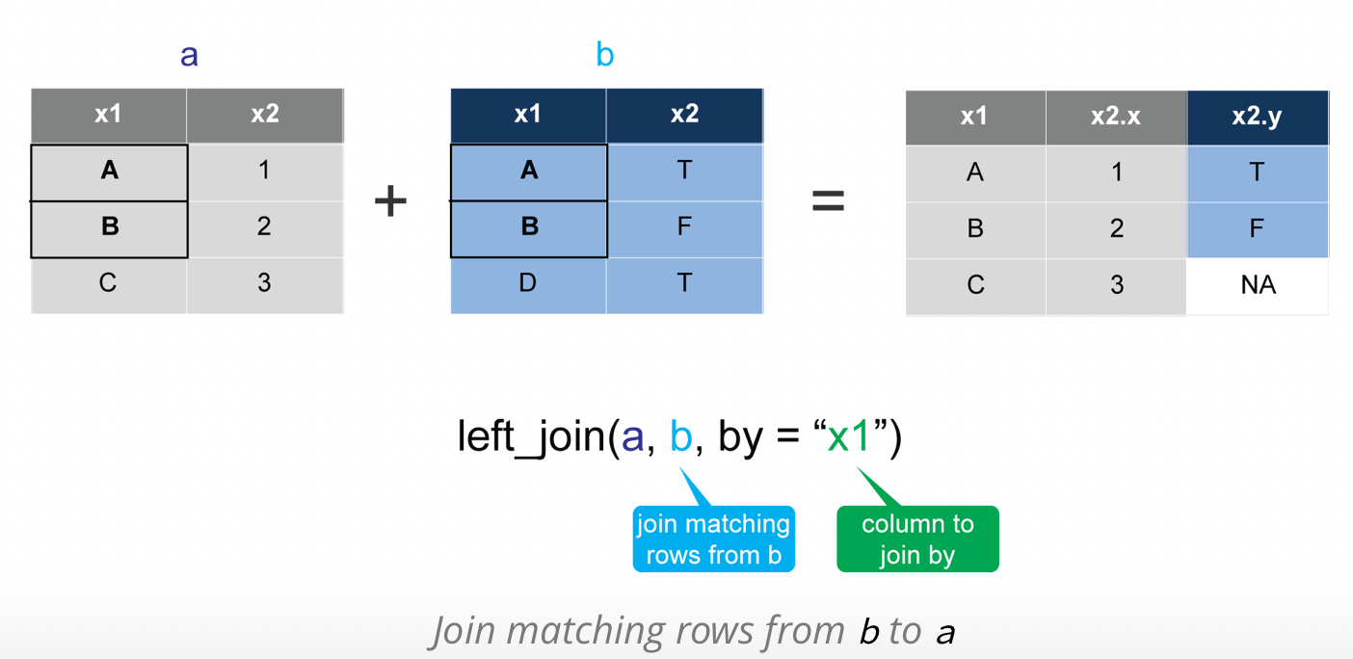
dplyr: primary functions

Slide 151
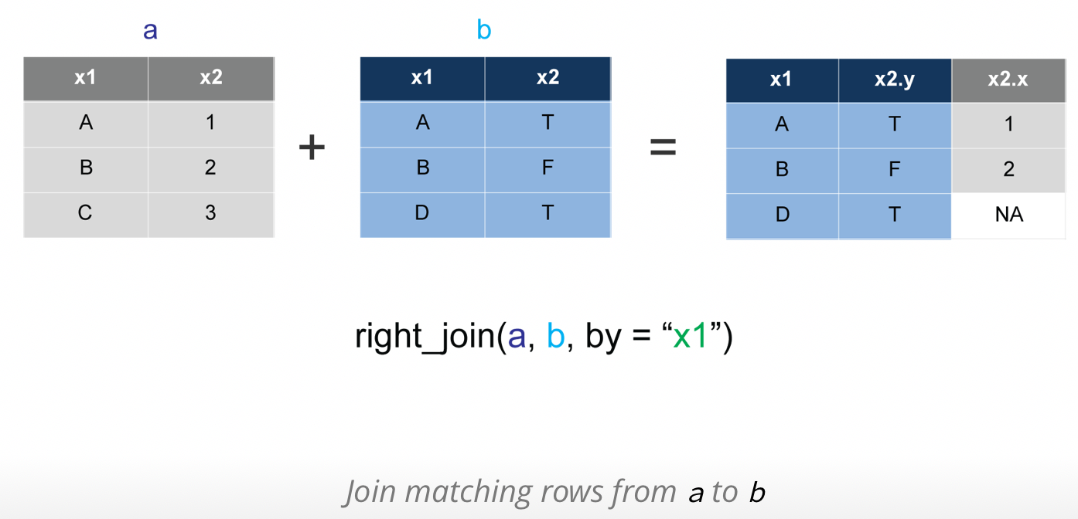
dplyr: primary functions

Slide 152
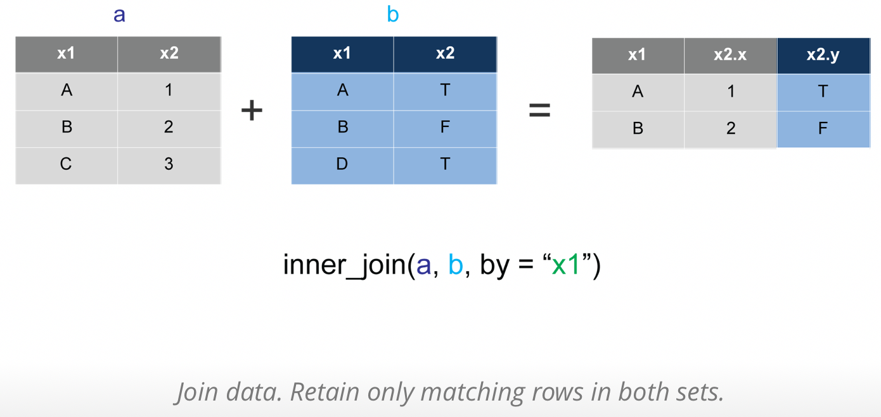
dplyr: primary functions

Slide 153
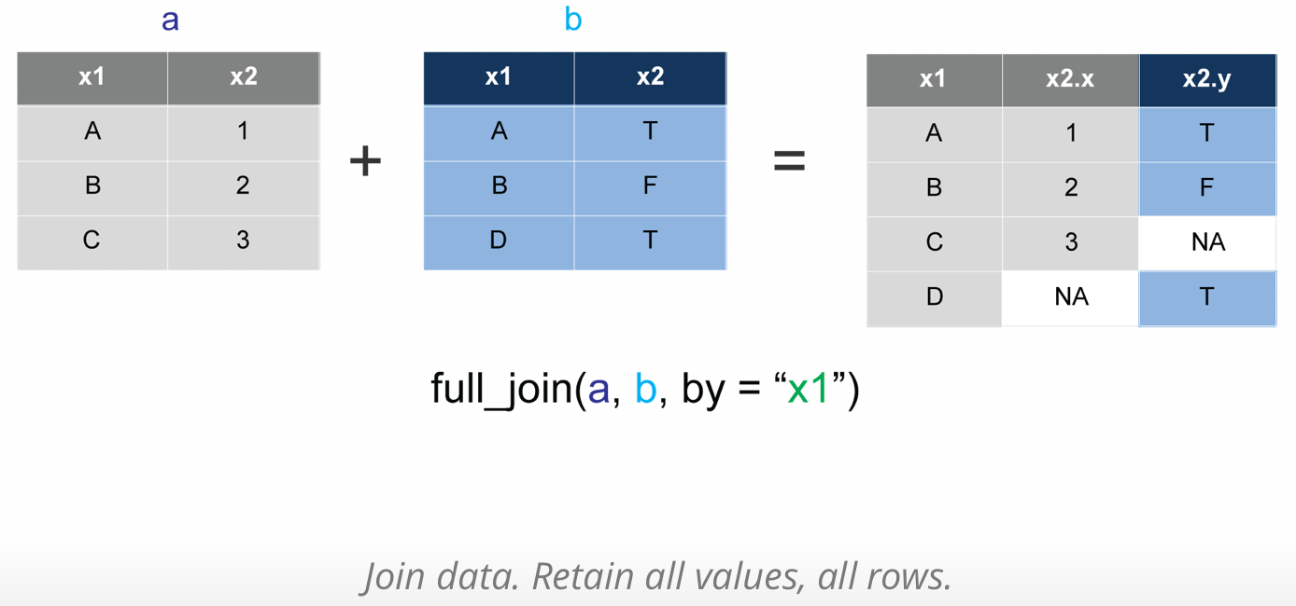
dplyr: primary functions

Slide 154
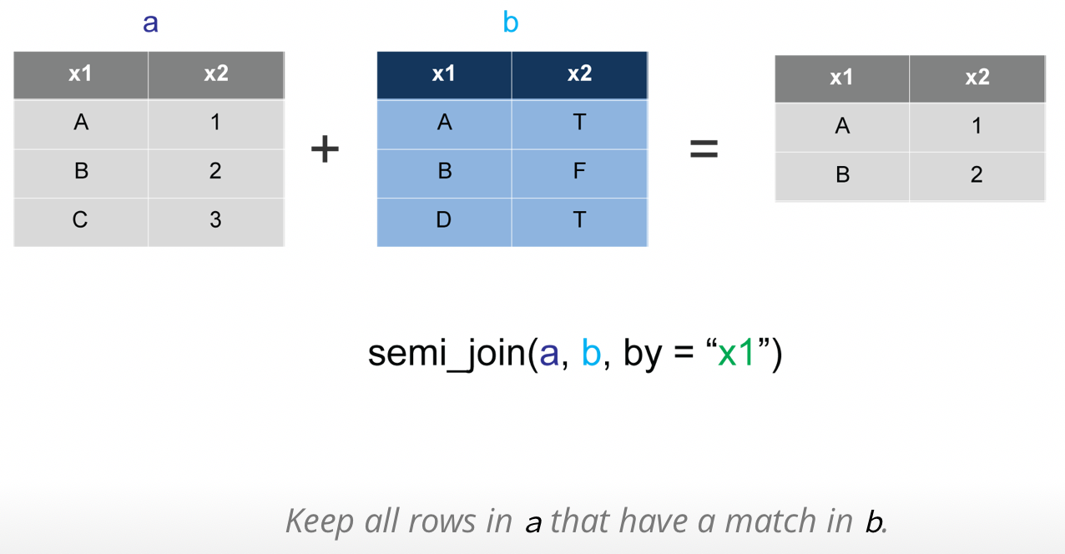
dplyr: primary functions

Slide 155
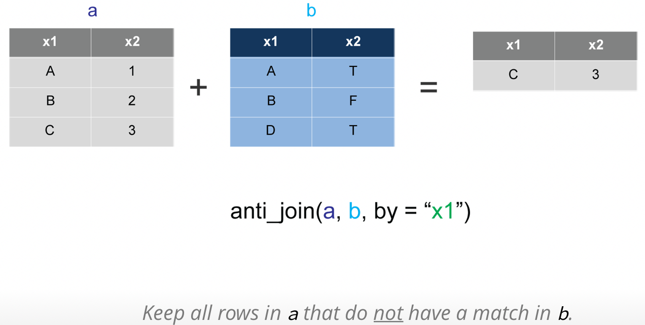
dplyr: primary functions

Slide 156
Plotting with ggplot2

Slide 157
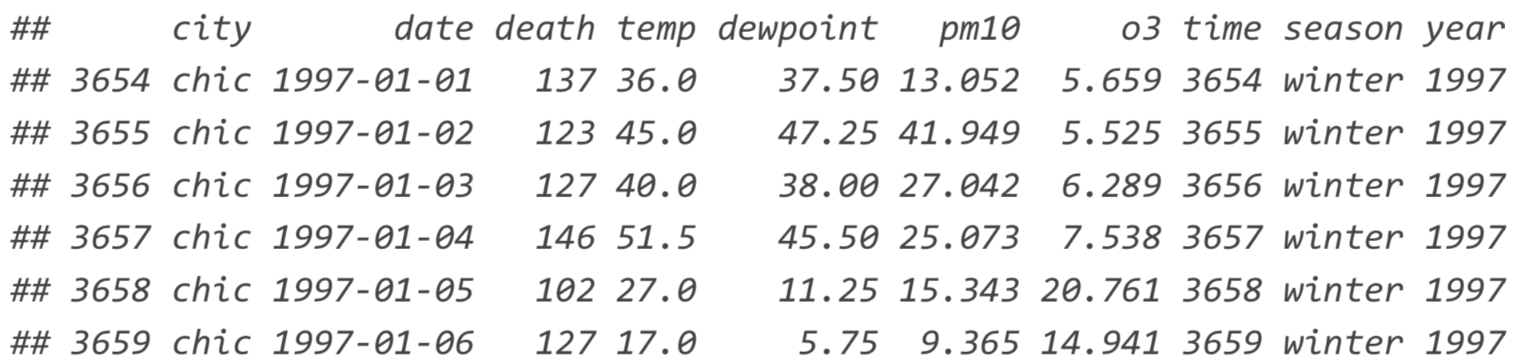
Plotting using ggplot – the dataset
We're using data from the National Morbidity and Mortality Air Pollution Study (NMMAPS)
To make the plots manageable we're limiting the data to Chicago and 1997-2000
> library(ggplot2) > nmmaps<‐read.csv("chicago‐nmmaps.csv",as.is=T)
> nmmaps$date<‐as.Date(nmmaps$date)
> nmmaps<‐nmmaps[nmmaps$date>as.Date("1996‐12‐31"),]
> nmmaps$year<‐substring(nmmaps$date,1,4) > head(nmmaps)

Slide 158
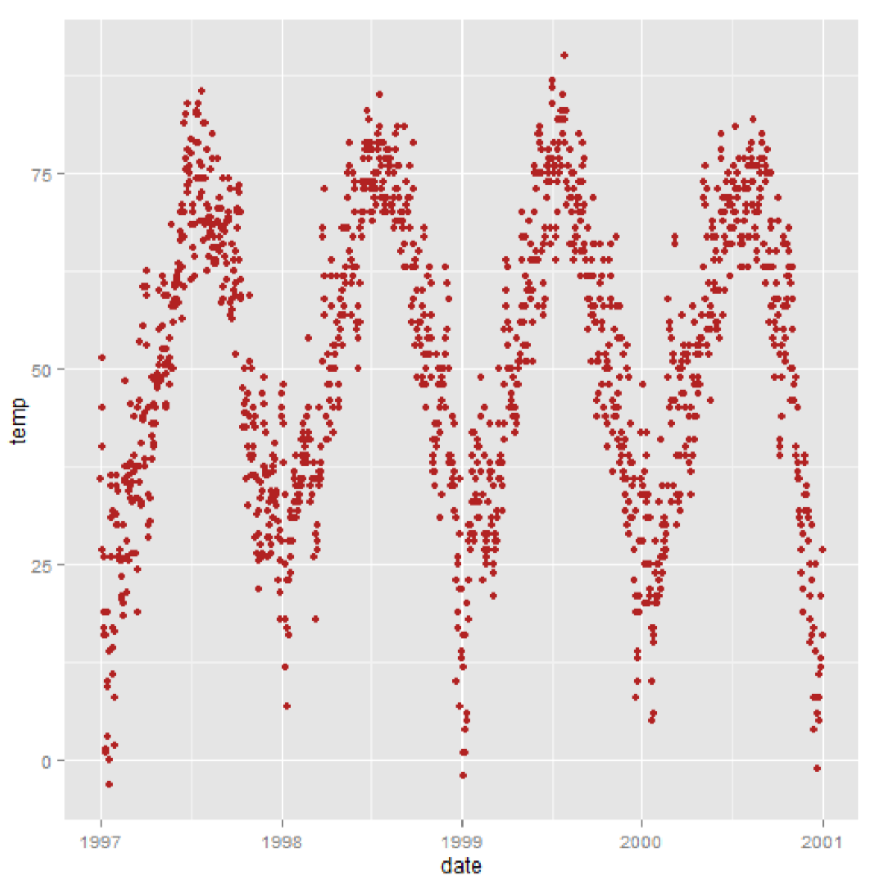
Plotting using ggplot – a default plot
> g<‐ggplot(nmmaps,aes(date,temp)) + geom_point(color="firebrick")
> g

Slide 159
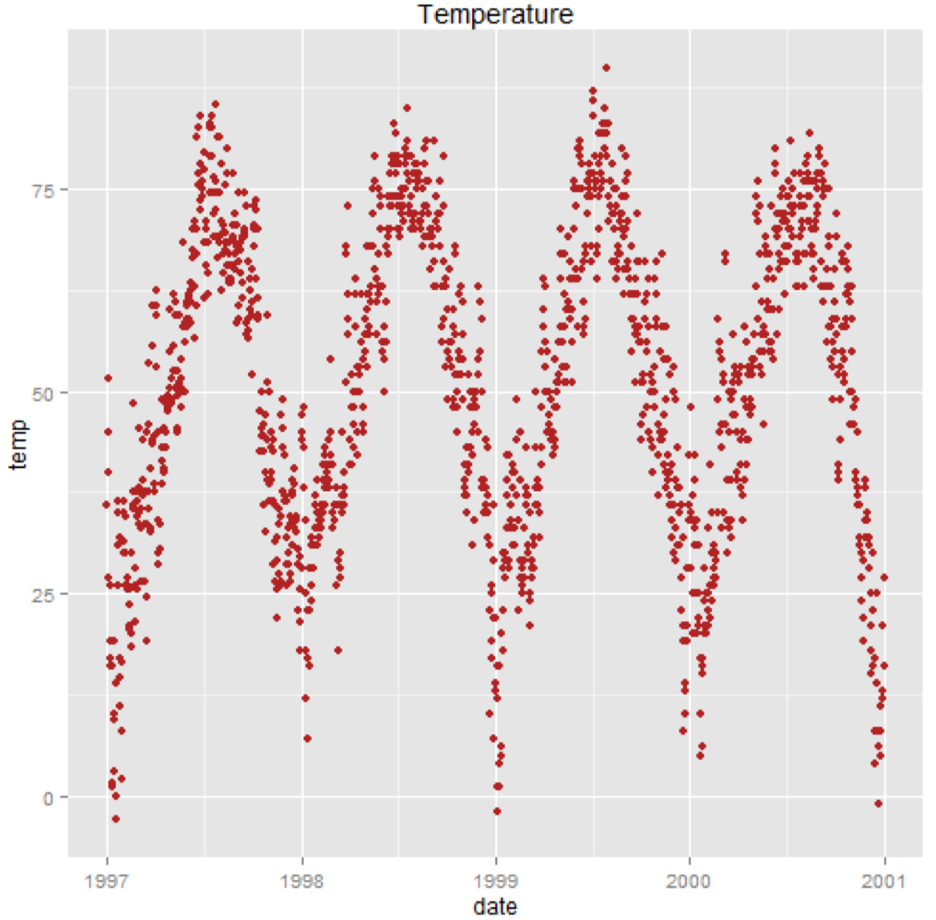
Plotting using ggplot – working with the title
> g <‐ g + ggtitle('Temperature')
> g

Slide 160

Plotting using ggplot – title size and face
> g+theme(plot.title=element_text(size=20,face="bold",vjust=2))

Slide 161

Plotting using ggplot – title font
> library(extrafont)
> g+theme(plot.title=element_text(size=30,lineheight=.8, vjust=1,family="Bauhaus93"))

Slide 162

Plotting using ggplot – title font
> g<‐g+ggtitle("This is a longer\ntitle than expected")
> g+theme(plot.title=element_text(size=20,face="bold",vjust=1,lineheight=0.6))

Slide 163

Plotting using ggplot – working with axis
> g <‐ g + xlab(“Date”) + ylab(expression(paste0("Temperature(",degree~F,")"))
> g

Slide 164

Plotting using ggplot – axis text and ticks
> g + theme(axis.ticks.y=element_blank(),axis.text.y=element_blank())
> g

Slide 165

Plotting using ggplot – change size and rotate axis text
> g + theme(axis.text.x=element_text(angle=50,size=20,vjust=0.5))
> g

Slide 166

Plotting using ggplot – axis title colours
> g + theme( axis.title.x=element_text(color="forestgreen",vjust=‐0.35), axis.title.y=element_text(color="cadetblue",vjust=0.35) )

Slide 167

Plotting using ggplot – limit an axis to a range
> g + scale_x_continuous(limits=c(0,35))

Slide 168

Plotting using ggplot – working with the legend
> g <‐ ggplot(nmmaps, aes(date,temp,color=factor(season)))+
geom_point()
> g

Slide 169

Plotting using ggplot – turn off the legend title
> g+theme(legend.title=element_blank())

Slide 170

Plotting using ggplot – change the title of the legend
> g + theme(legend.title=element_text(colour="chocolate",size=16,face="bold")) +
scale_color_discrete(name="This color is\ncalled chocolate!?")

Slide 171

Plotting using ggplot – creating multi-panel plots
> ggplot(nmmaps, aes(date,temp)) +
geom_point(color="aquamarine4") +
facet_wrap(~year,nrow=1)

Slide 172

Plotting using ggplot – matrix of plots
> ggplot(nmmaps,aes(date,temp)) +
geom_point(color="chartreuse4") +
facet_wrap(~year, ncol=2)

Slide 173

Plotting using ggplot – individual scales
> ggplot(nmmaps,aes(date,temp)) +
geom_point(color="chartreuse4") +
facet_wrap(~year,ncol=2,scales="free")

Slide 174

Plotting using ggplot – multi-plot for multiple variables
> ggplot(nmmaps,aes(date,temp)) +
geom_point(color="darkgoldenrod4") +
facet_grid(year~season)

Slide 175

Plotting using ggplot – working with colours
> ggplot(nmmaps,aes(date,temp,color=factor(season))) + geom_point()+ scale_color_manual(values=c("dodgerblue4","darkolivegreen4",
"darkorchid3","goldenrod1"))

Slide 176

Plotting using ggplot – working with colours
> ggplot(nmmaps,aes(date,temp,color=factor(season))) +
geom_point() + scale_color_brewer(palette="Set1")

Slide 177

Plotting using ggplot – working with colours
> mid<‐mean(nmmaps$o3)
> ggplot(nmmaps,aes(date,temp,color=o3)) + geom_point()+ scale_color_gradient2(midpoint=mid, low="blue",mid="white",high="red")

Slide 178

Plotting using ggplot – working with annotations
> library(grid) > my_grob=grobTree(textGrob("Thistextstaysinplace!",x=0.1, y=0.95,hjust=0,
gp=gpar(col="blue",fontsize=15,fontface="italic")))
> ggplot(nmmaps, aes(temp,o3)) + geom_point(color="firebrick") +
annotation_custom(my_grob)

Slide 179

Plotting using ggplot – plot types (boxplot)
> g<‐ggplot(nmmaps,aes(x=season,y=o3))
> g+geom_boxplot(fill="darkseagreen4")

Slide 180

Plotting using ggplot – plot types (points)
> g + geom_point()

Slide 181

Plotting using ggplot – plot types (jitter plot)
> g+geom_jitter(alpha=0.5,aes(color=season),position=position_jitter(width=.2))

Slide 182

Plotting using ggplot – plot types (violin plot)
> g + geom_violin(alpha=0.5,color="gray")

Slide 183

Plotting using ggplot – plot types (violin plot)
> g+geom_violin(alpha=0.5,color="gray") +
geom_jitter(alpha=0.5,aes(color=season),position=position_jitter(width=0.1)) + coord_flip()

Slide 184

Plotting using ggplot – plot types (smooth lines)
> ggplot(nmmaps,aes(date,temp)) + geom_point(color="firebrick") +
stat_smooth()

Slide 185

Plotting using ggplot – plot types (linear fit)
> ggplot(nmmaps,aes(temp,death)) + geom_point(color="firebrick") + stat_smooth(method="lm", se=FALSE)

Slide 186
Bioconductor

Slide 187
What is Bioconductor?
Analysis and comprehension of high-throughput genomic data
Statistical analysis: large data, technological artifacts, …
Comprehension: biological context, visualization, reproducibility
High-throughput
Sequencing: RNAseq, ChIPSeq, variants, copy number, …
Microarrays: Expression analysis
Flow cytometry, proteomics, images, …
Packages, vignettes, work flows
1000+ software packages
‘Annotation’ packages – static data bases of identifier maps, gene models, pathways
‘Experimental’ packages – data sets
‘Vignettes’ are an important feature in Bioconductor – documents illustrating how to use the packages, with integrated code
Go to Bioconductor’s website and navigate to different packages

Slide 188
Exercise - Biostrings
## Bioconductor
> source("https://bioconductor.org/biocLite.R") > biocLite("Biostrings")
## Read in a fasta sequence
> myDNA <- readDNAStringSet("~/Desktop/fasta/A_nuc.fasta") > length(myDNA)
## Subset sequences
> myDNASeq <- myDNA[1]
> myDNASeq <- myDNA[names(myDNA)==names(myDNA)[1]]
> nchar(myDNASeq)
> class(myDNASeq)
> subseq(myDNASeq, start = 2, end = 10)
## Complement
> cmp <- complement(myDNASeq)
> cmp

Slide 189
Exercise - Biostrings
## Reverse
> rvs <- reverse(myDNASeq)
> rvs
## Reverse complement
> rvscmp <-reverseComplement(myDNASeq)
> rvscmp
## Translate
> GENETIC_CODE
> protein<-translate(myDNASeq, genetic.code = GENETIC_CODE)
> protein
> Amino<-AMINO_ACID_CODE[strsplit(as.character(protein), “”)[[1]]]
> Amino
## Alignment
> DNA1 <- myDNA[1]
> DNA2 <- myDNA[4000]
> galign <-pairwiseAlignment(DNA1, DNA2)
> galign

Slide 190
Exercise - Biostrings
## Define substitution matrix
> matrix <- nucleotideSubstitutionMatrix(match = 1, mismatch = -3, baseOnly = TRUE)
> galign <-pairwiseAlignment(DNA1, DNA2,substitutionMatrix = matrix)
> print(galign)
## More specialized functions – palindromes
> RNA1 <-RNAString("AAGAAAACCAUGAUGGAAGCCAG")
> palindrome<-findPalindromes(RNA1)
> print(palindrome)
## Oligonucleotides
> trinucleotideFrequency(DNA1)
> oligonucleotideFrequency(DNA1,4)

